Slide 1
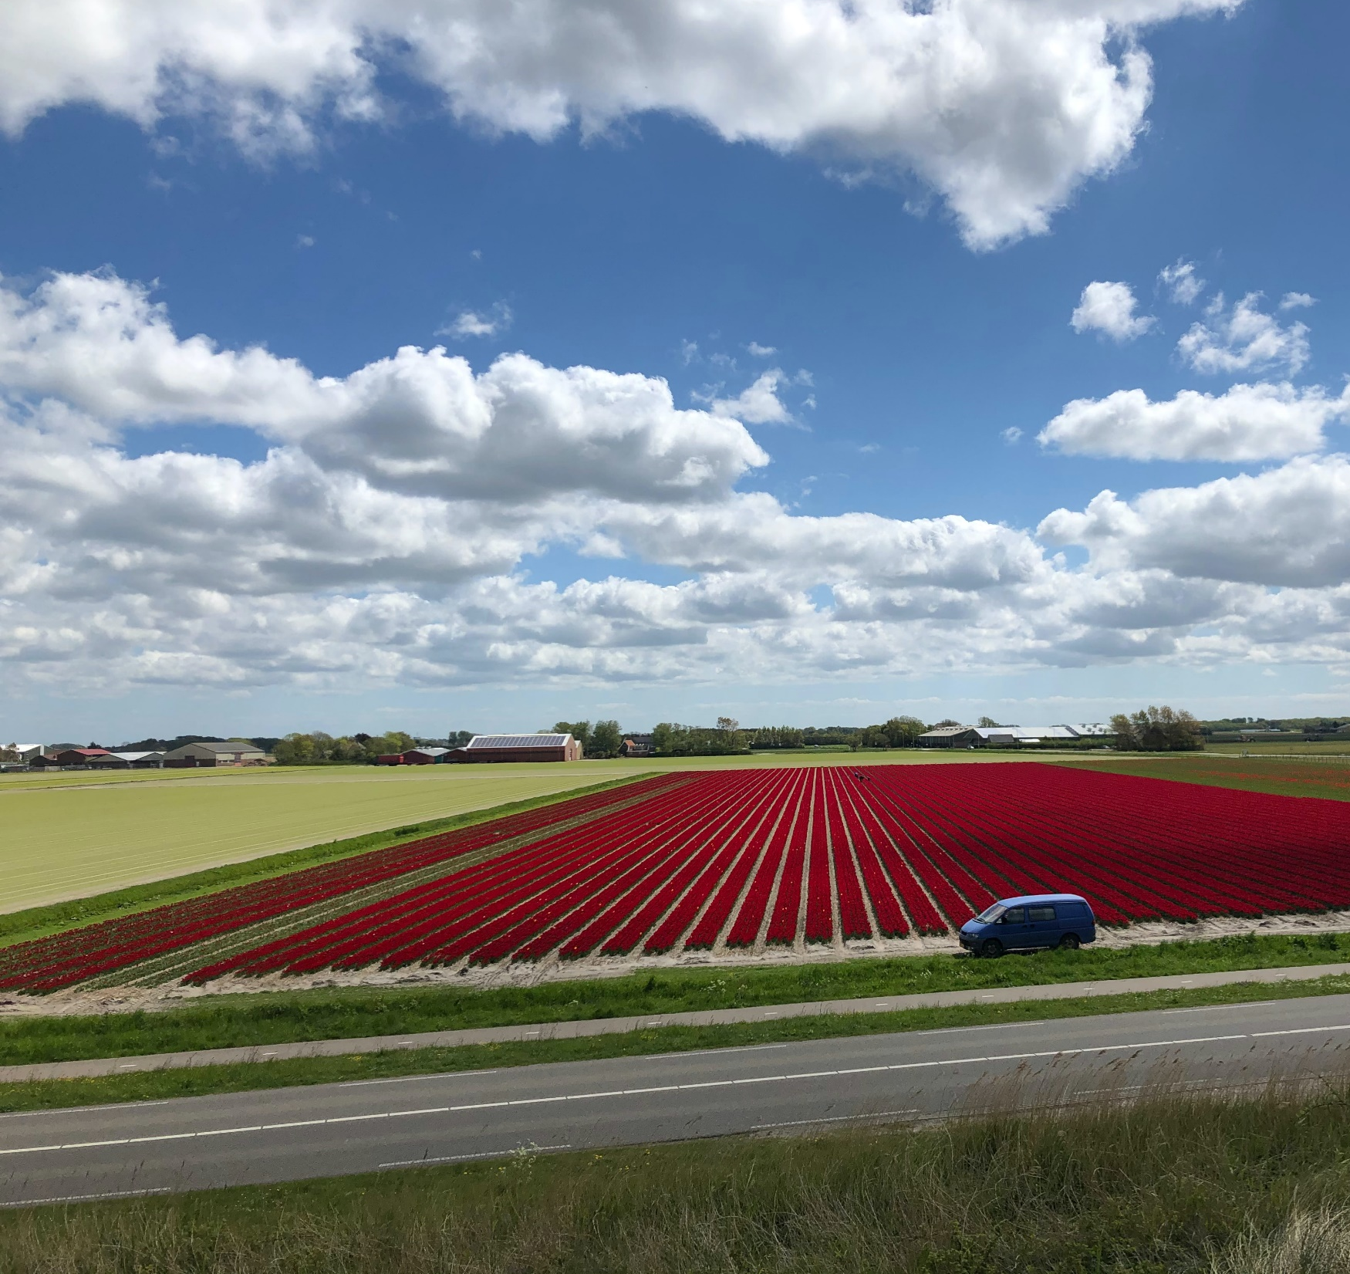
Callantsoog Water System Redesign
Group 5:
Anne Versleijen
Christine Martin
David Haasnoot
Dwiva Anbiya Taruna
Thomas Poort
Notes:
Hello everyone, we're group 5. My name is David Haasnoot & this is Anne versleijen, and we will be looking at our strategy for the redesign of the callantsoog water system

Slide 2



Project Goal Design a realistic, simpler and more robust water distribution system for Callantsoog.
Notes:
The goal of the project is to Design a realistic, simpler and more robust water distribution system for Callantsoog.

Slide 3
Overview
Problem: extreme rain events lead to flooding and subsequent damages of stakeholders’ property.
Proposed strategies:
Reduction in the amount of water level decrees
31 decree levels → 10 decree levels
Impact: simplified and controllable
Additional water storage
Addition of flood plain north of the polder
Impact: robust for the coming century
Notes:
Our focus was mainly on extreme rainfall events and how to make the system better in dealing with these.
We developed two strategies in order to tackle with this:
By reducing the number of decree levels from 31 to 10 it will simplify the control structures and make the system more manageble
To deal with excess water during extreme events by adding a larger water storage in the north east to reduce the steress on the system

Slide 4
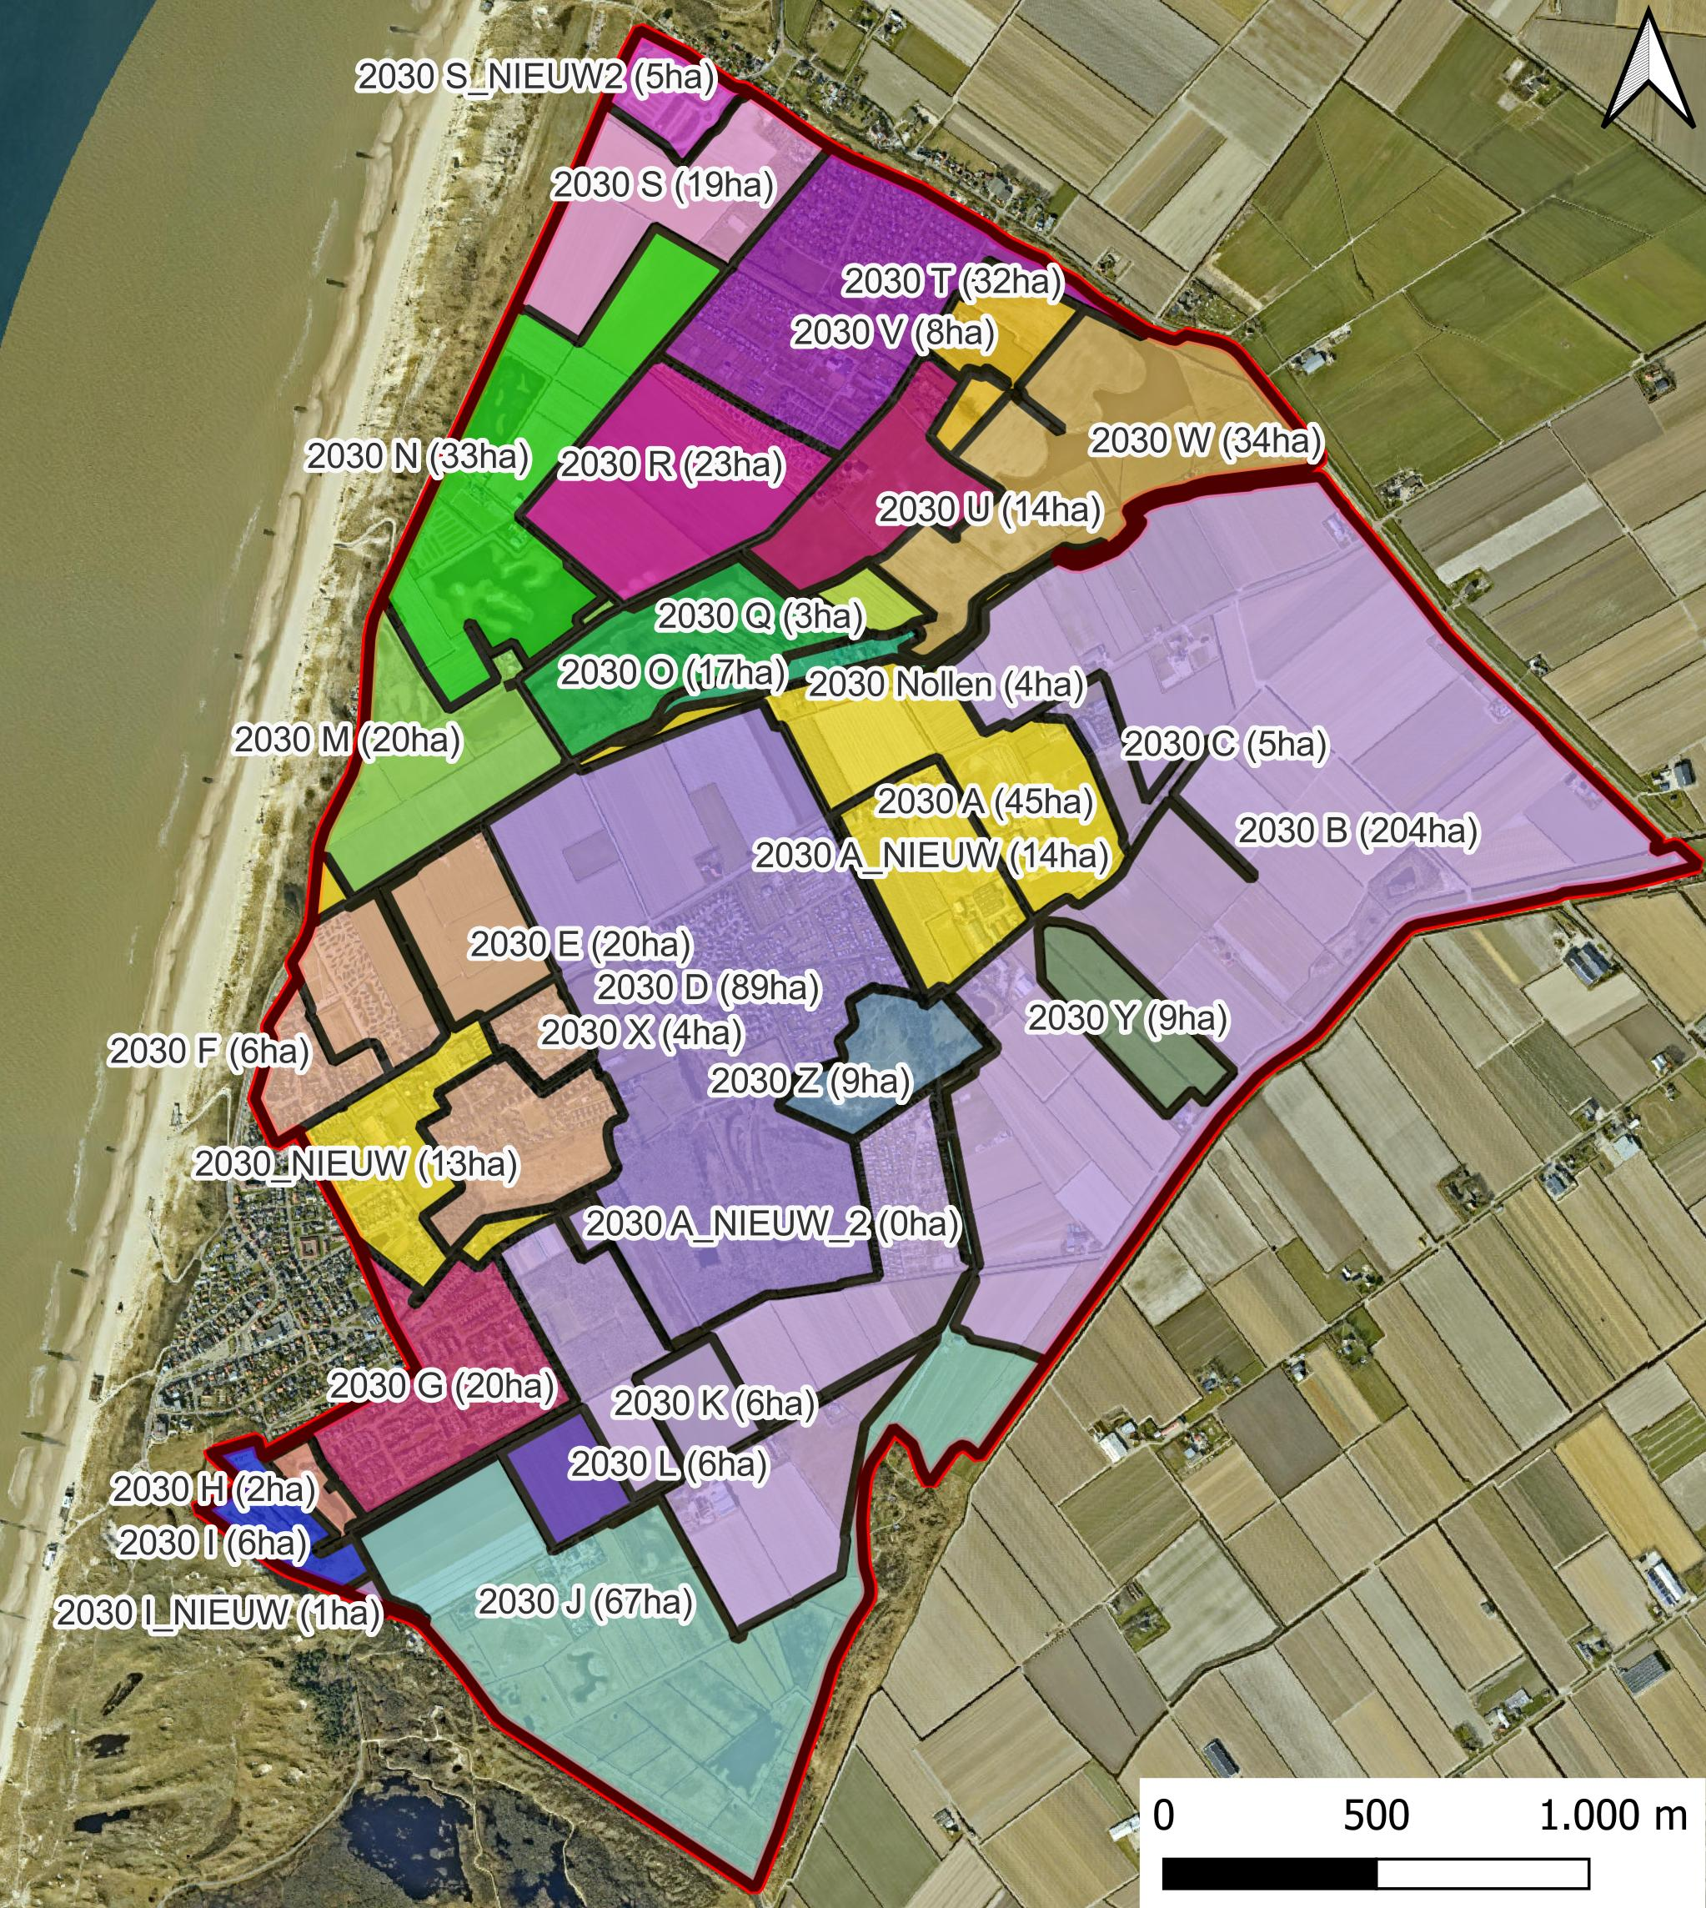
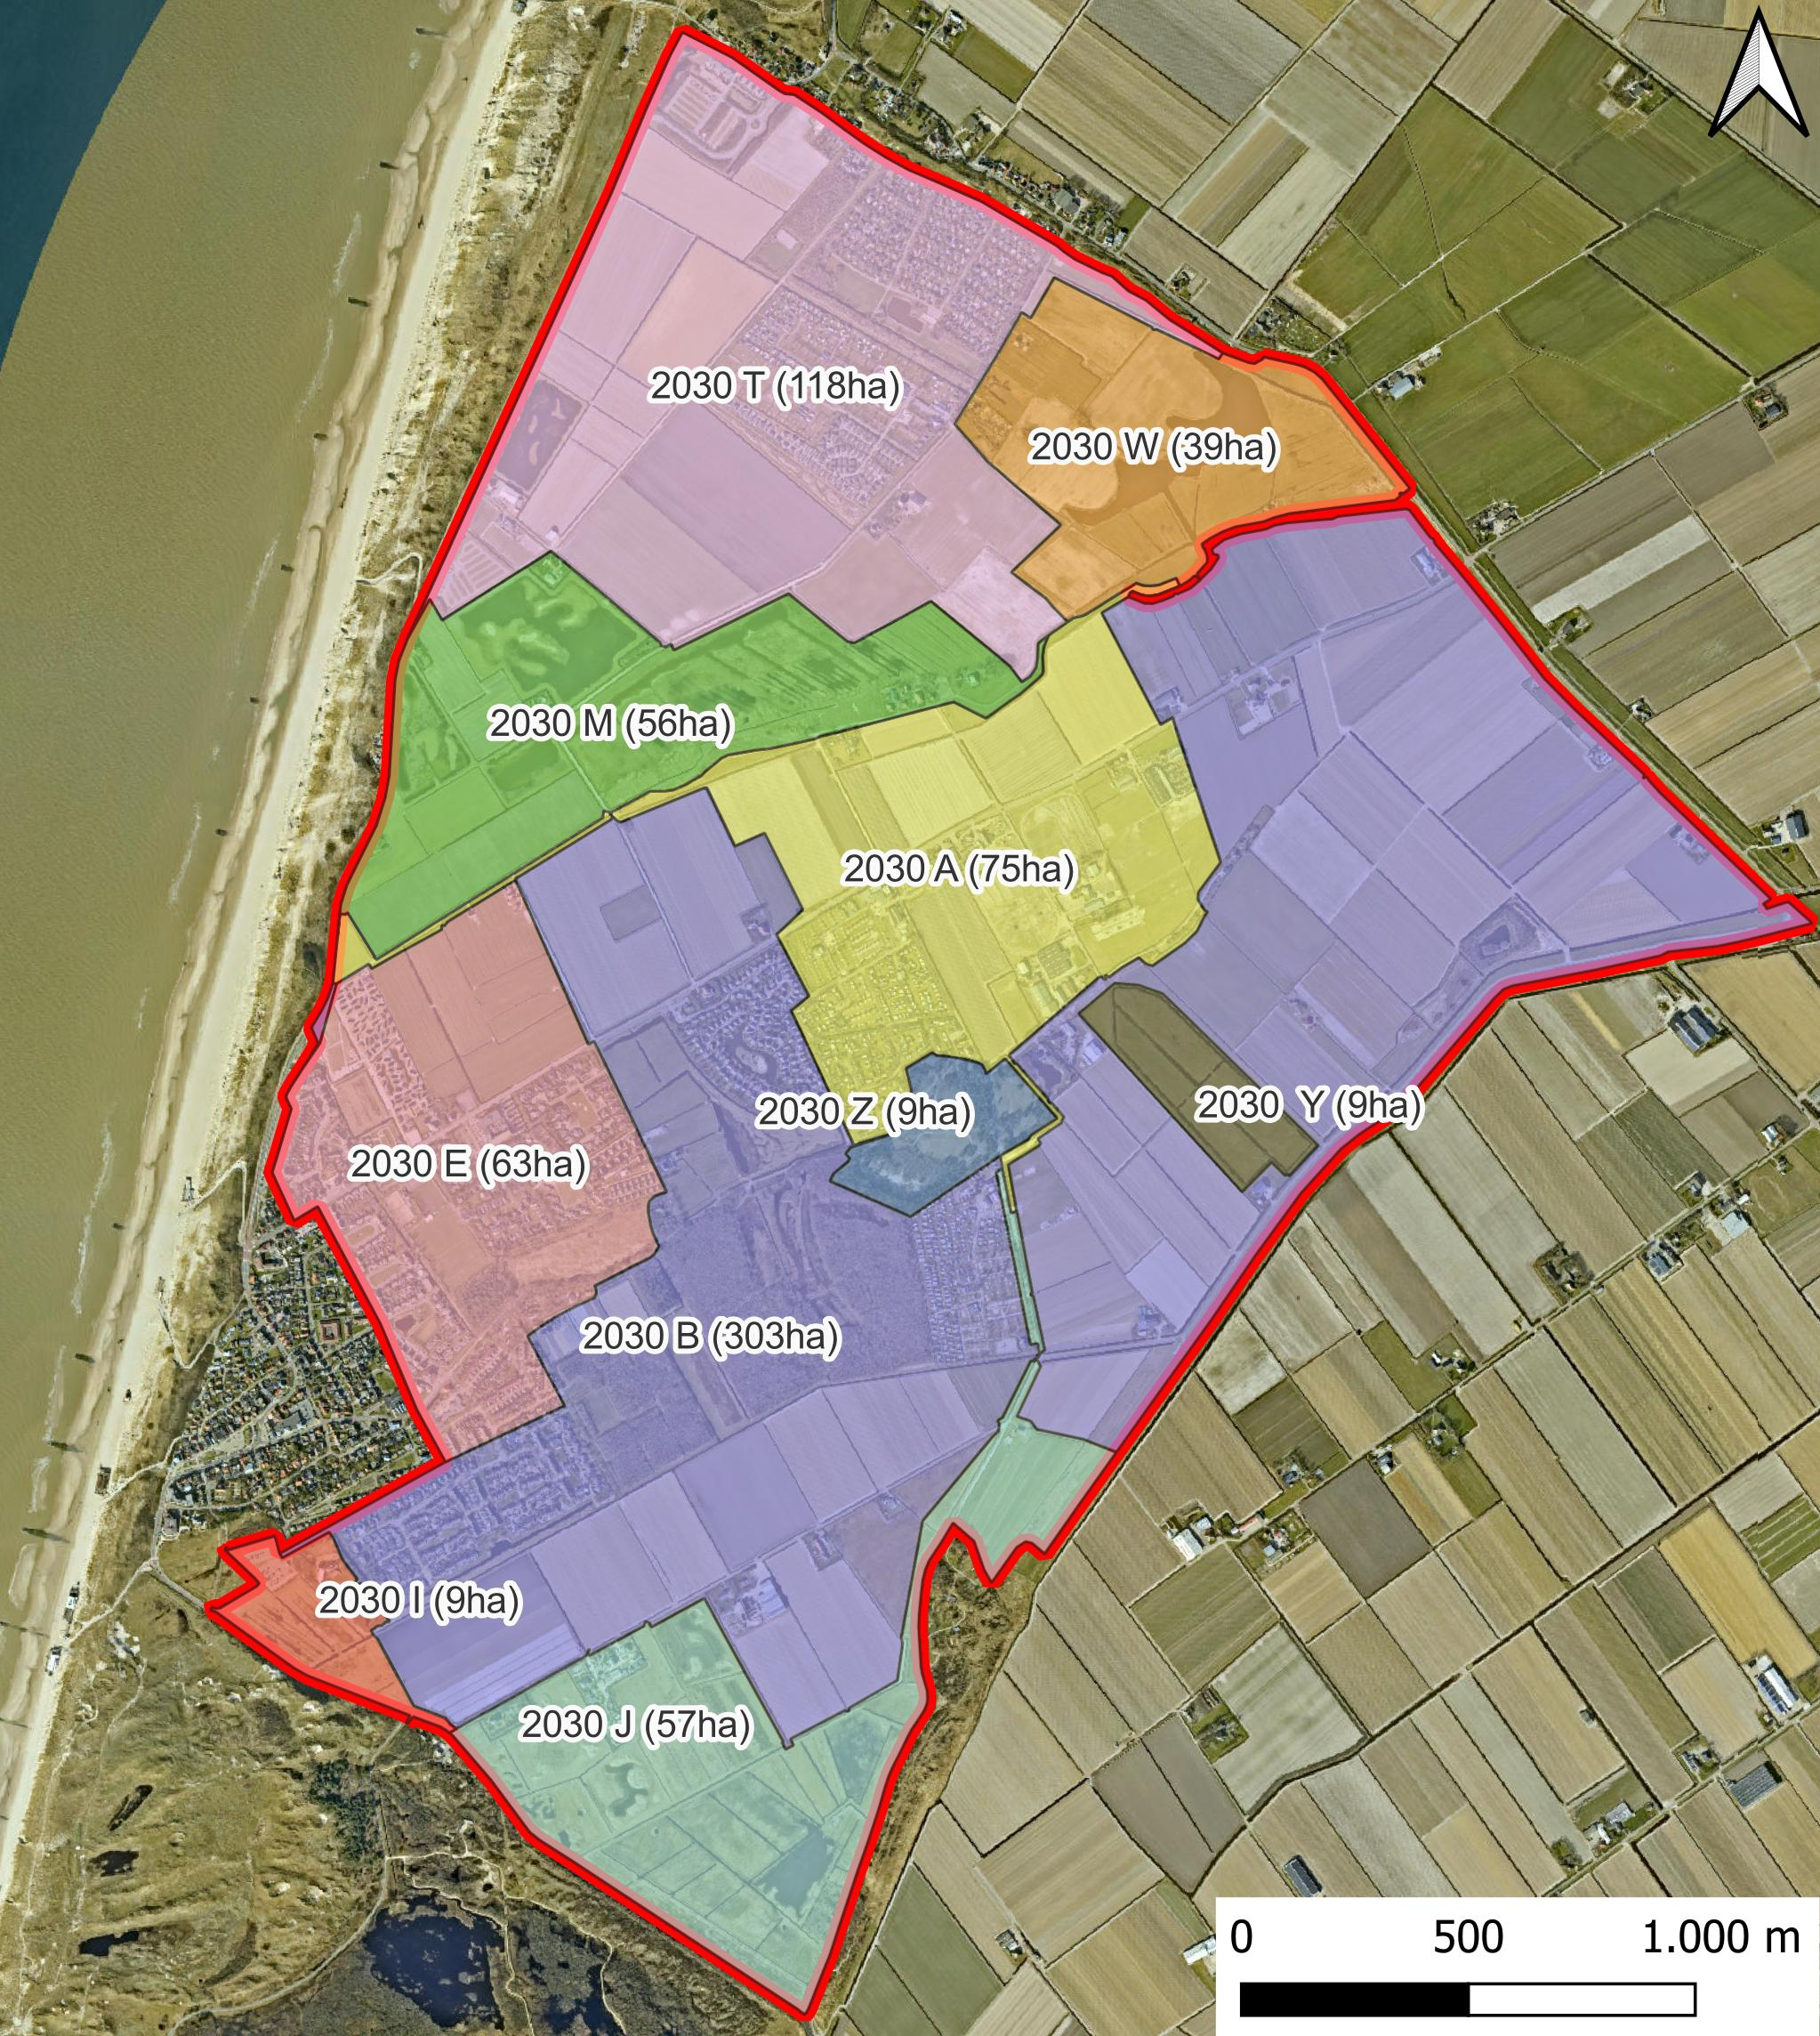
Change of water level decrees
Current
Proposed
Notes:
Here we see the current system with 31 water level decree systems, which vary in size and complexity.
Here is the new system we aimed to reduce this amount, however the nature areas are quite sensitive and different in operation.
For this reason they are left as their own regions. We formed these areas by looking at elevation, current & past land use and infrastructure.
The main consequence of changing the water decree level is that the levels decrease. This allows more storage of water when large amount of rainfall occurs suddenly.

Slide 5
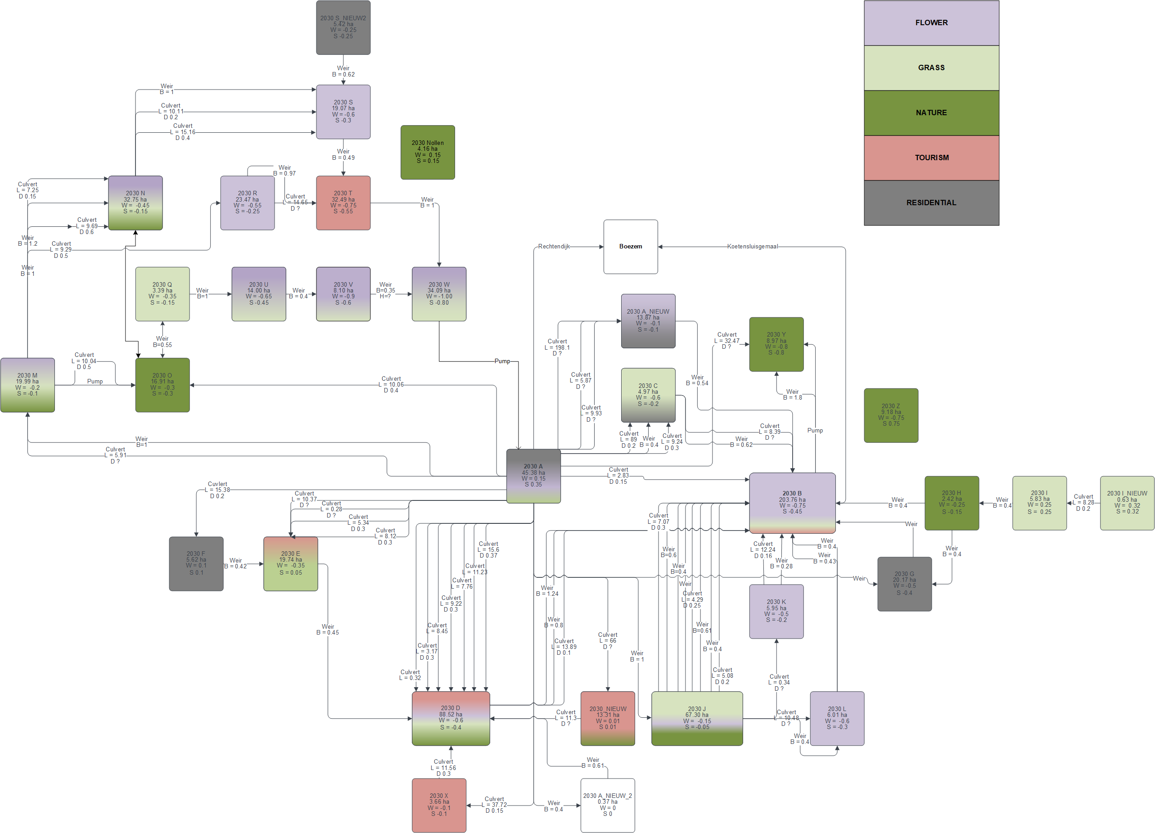
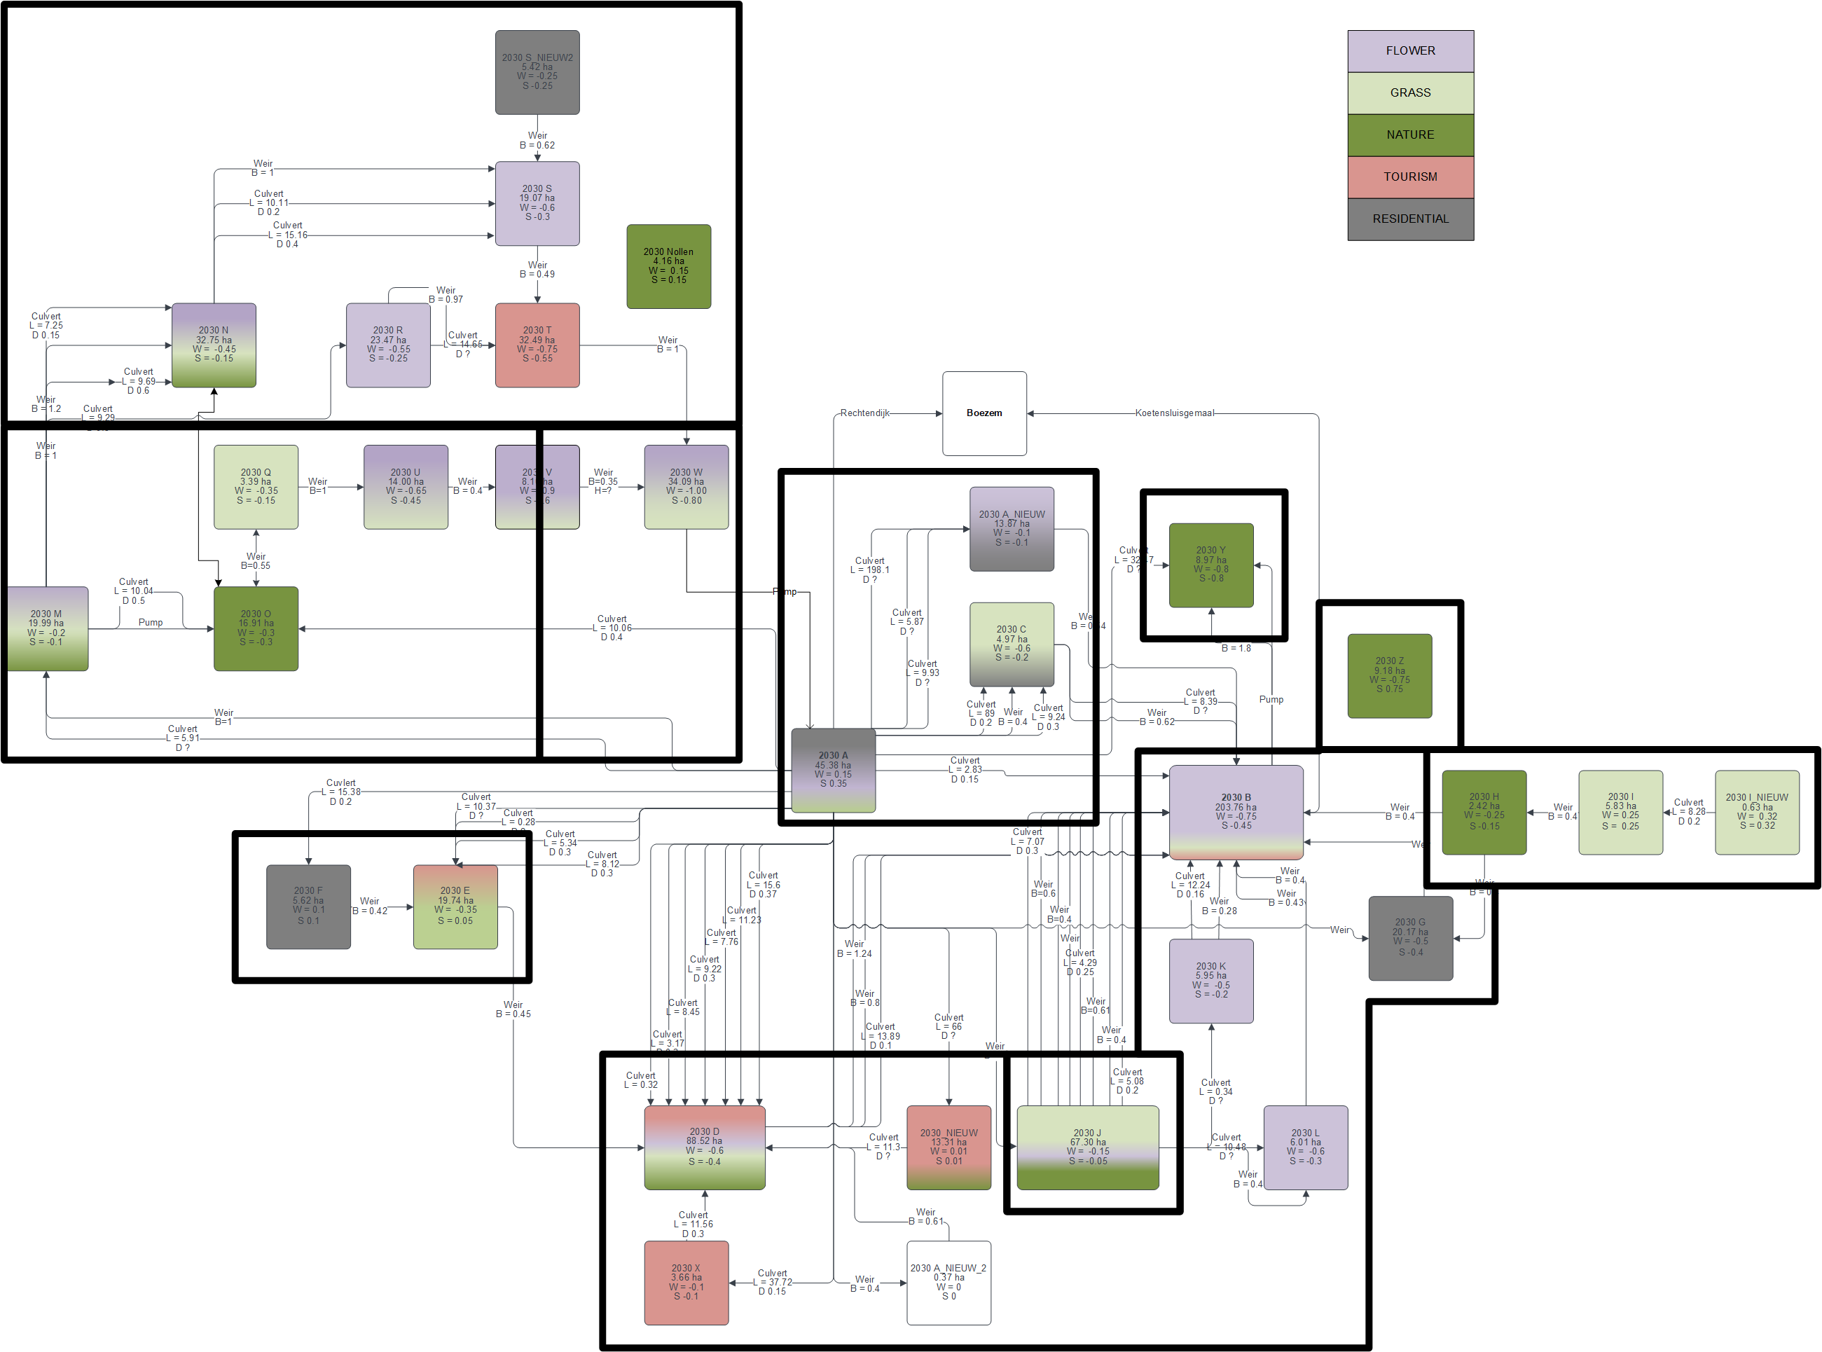
Change of water level decrees
Current
Proposed
Notes:
This is another representation of the system we just saw, this highlights the complexity of the current system.

Slide 6
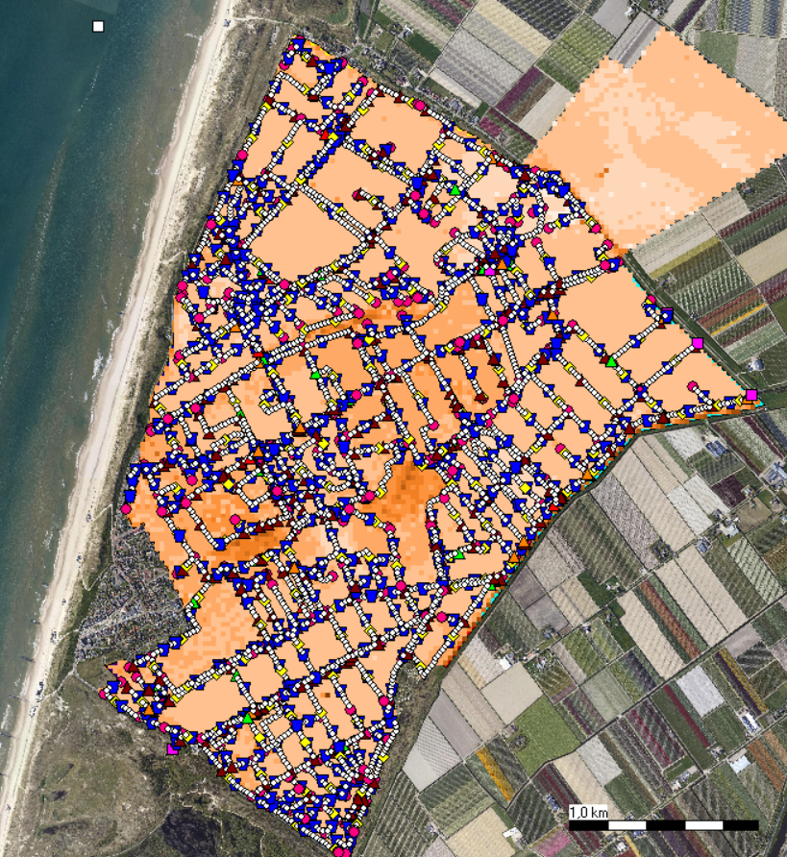

SOBEK Model
made with SOBEK
Notes:
We used a sobek model of the area to run a series of simulations to show how the system reacts. First we looked at the exisiting system and then compared how our changes are effectesd by it. The model is but a representation of reality, thus intercoparison is the best way to access how changes work/

Slide 7
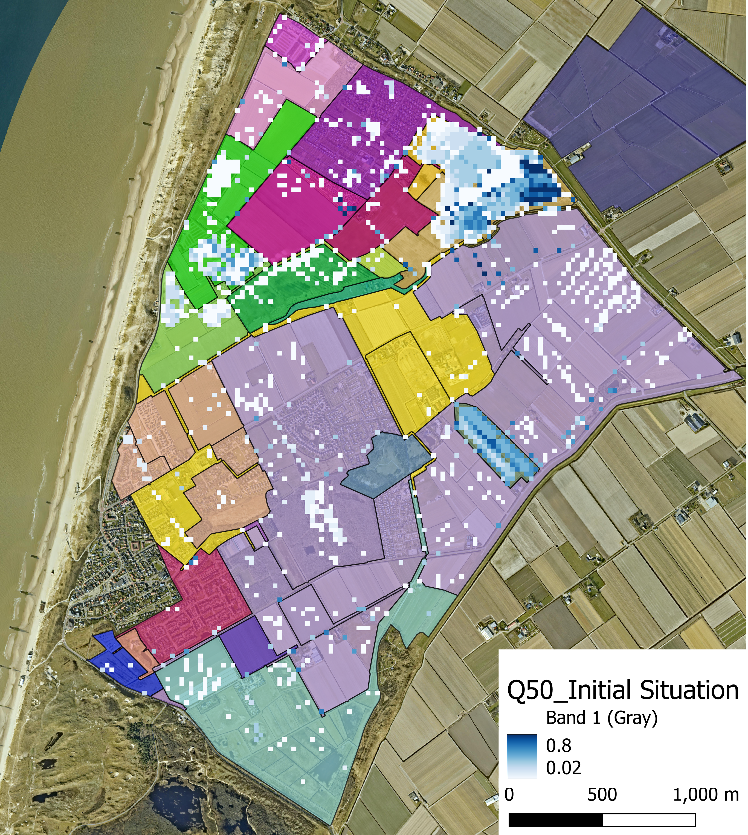
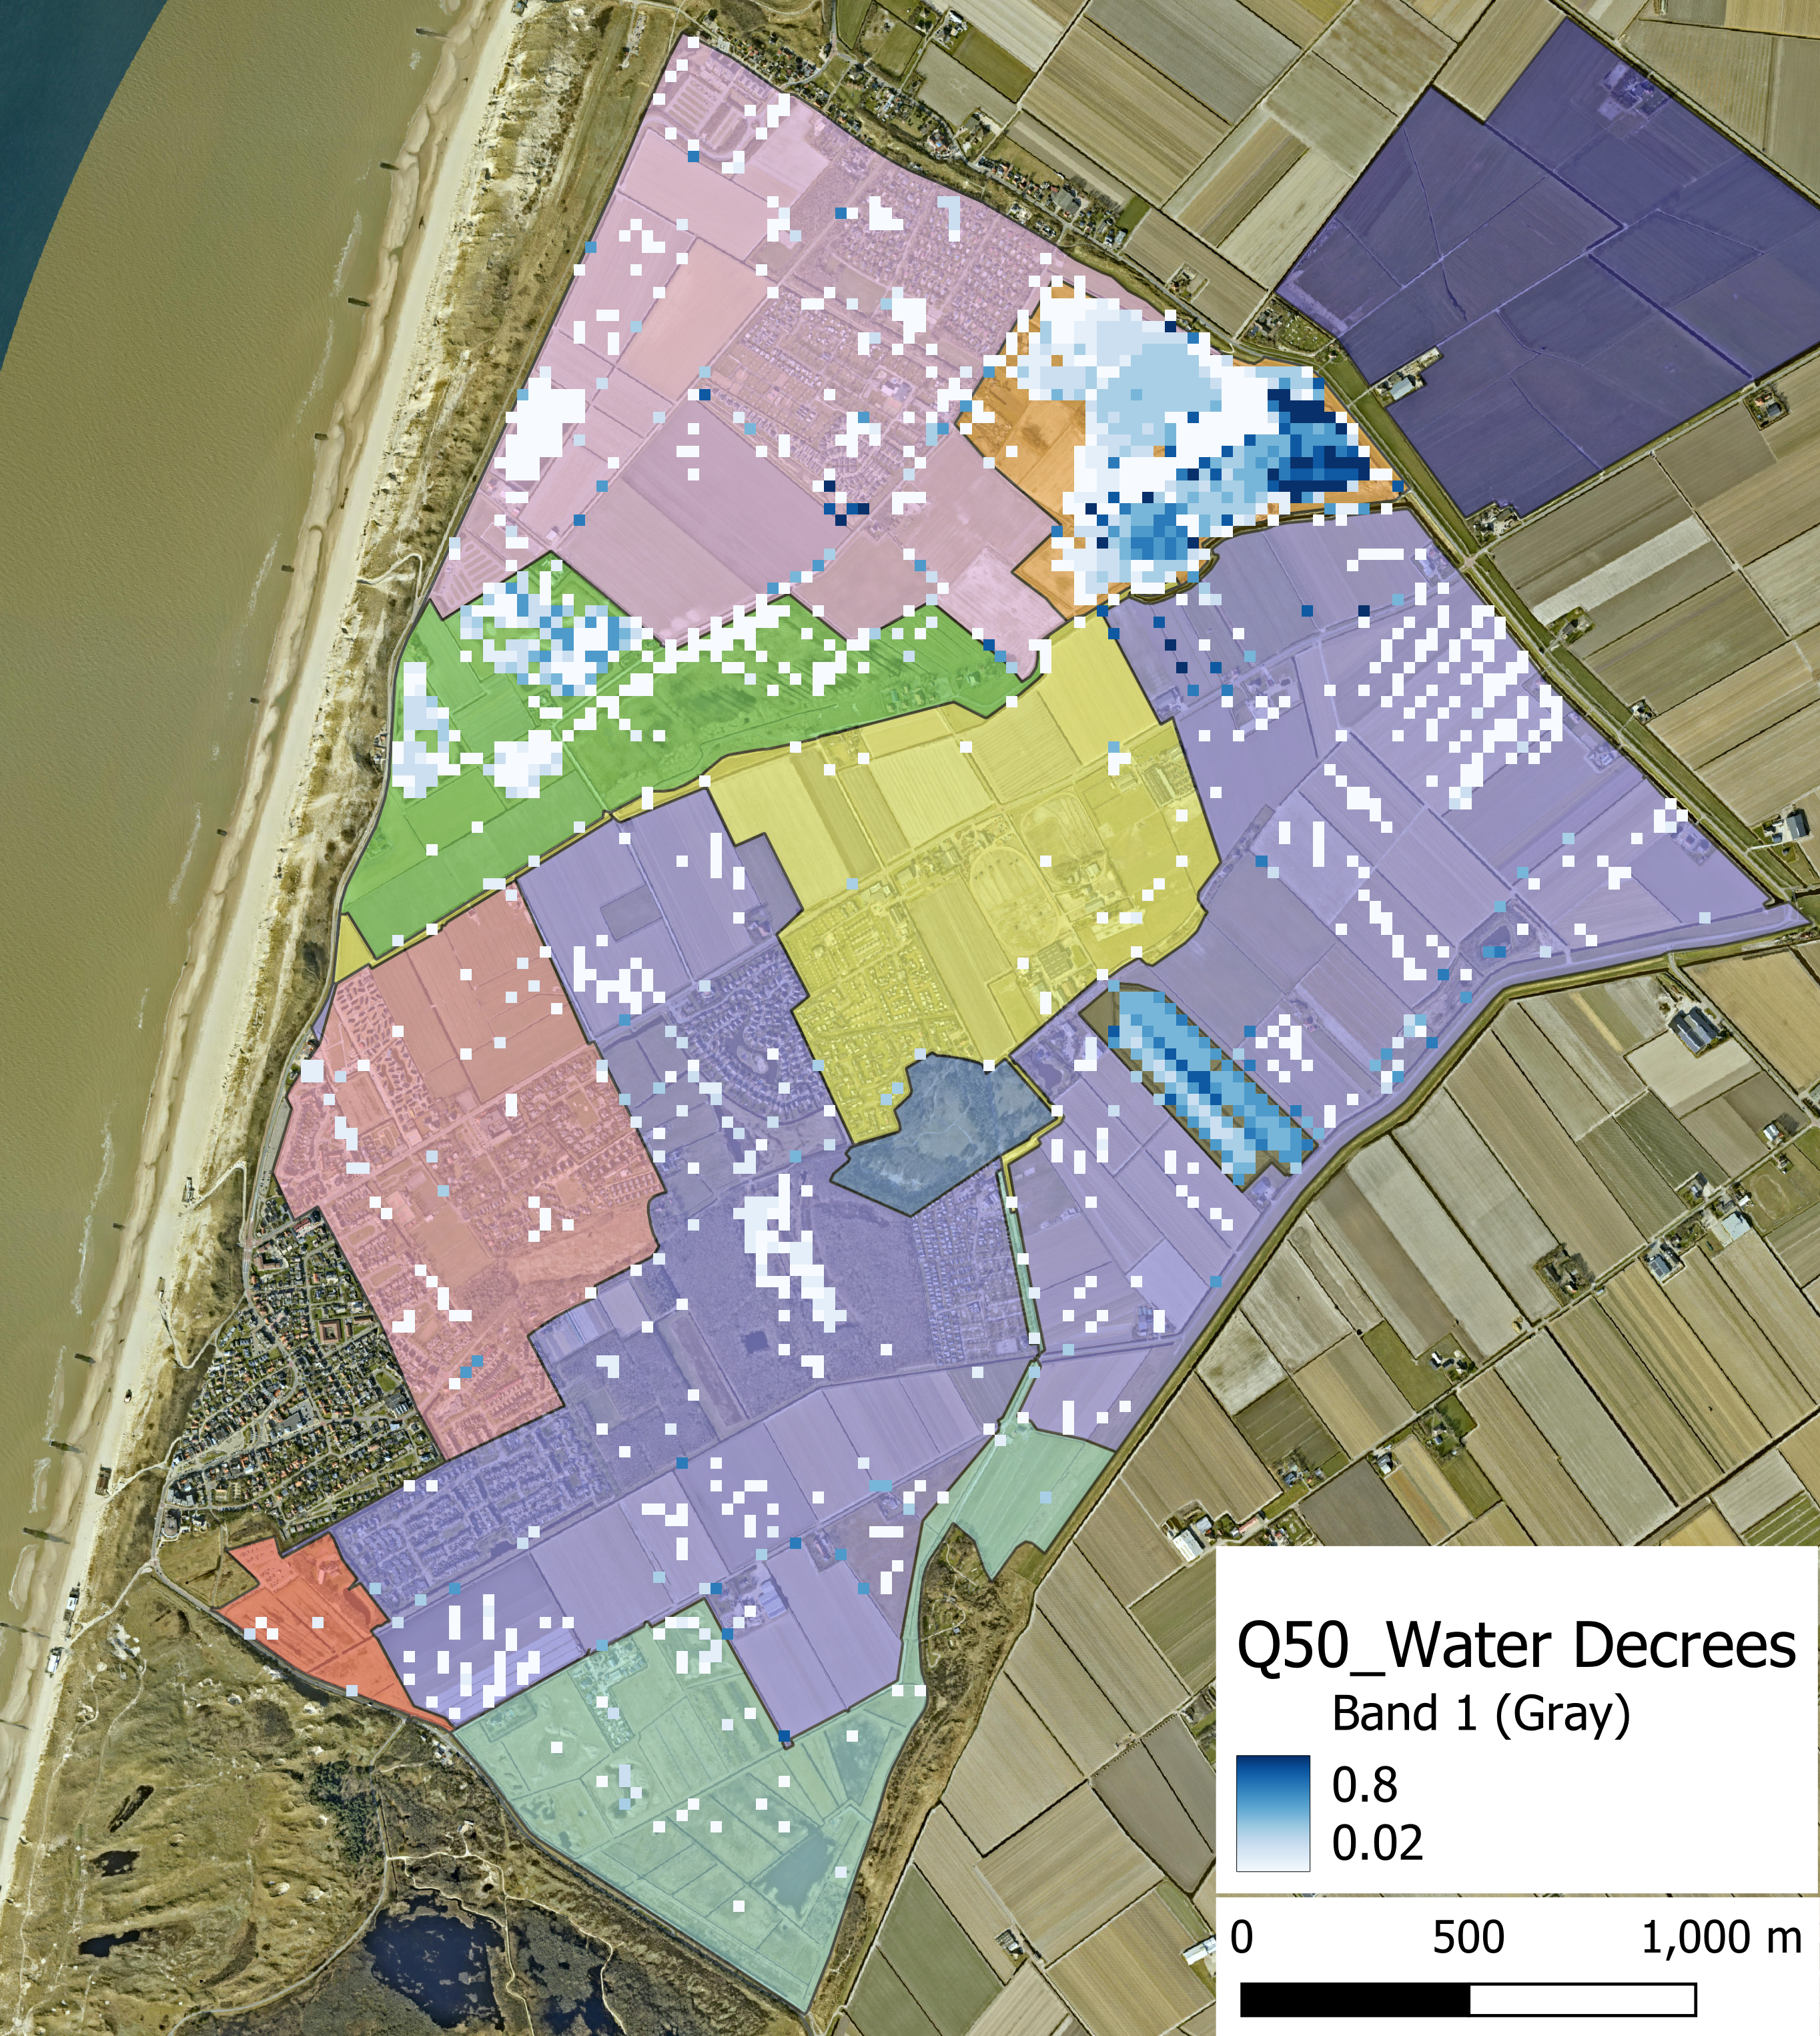
Results
Current
Proposed
T50 - 69.5mm in 24hrs,
model length 3d after rain
8% Flood extent decrease
Notes:
Here we see the current system moddeled for a rain event with a return period of 50 years.
This consists of 70mm across 24 hrs with a peak of around 8mm in a short time.
The decrease of 8% isn't much, but it shows that with less water decree levels the flood extent is still similar.
Most of the heavy areas flooded here are designated to flood as these are non-essential grasslands or nature areas which can cope with some water.

Slide 8
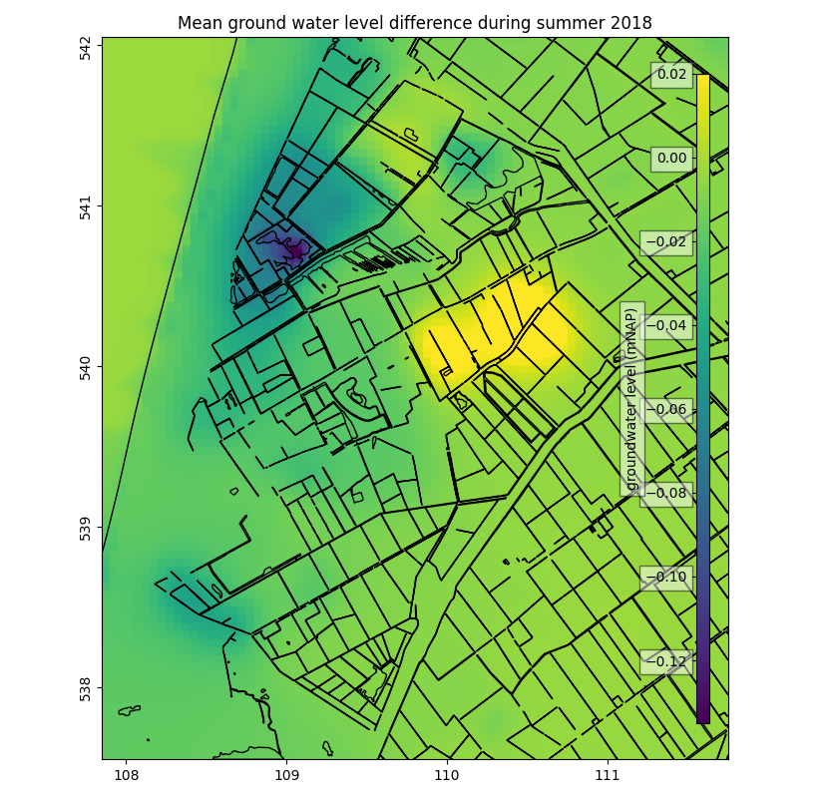
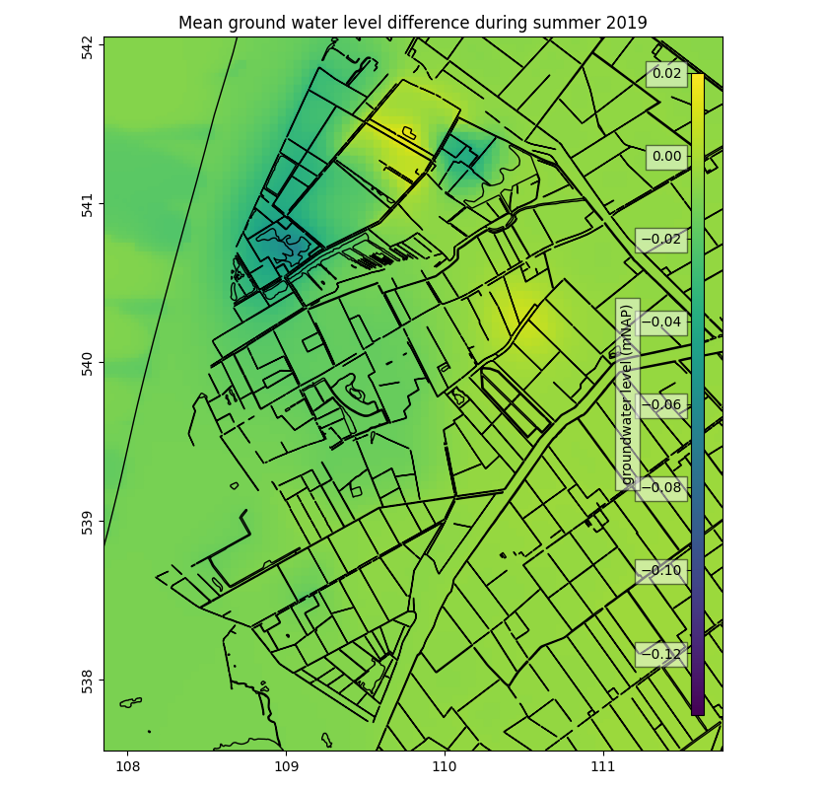
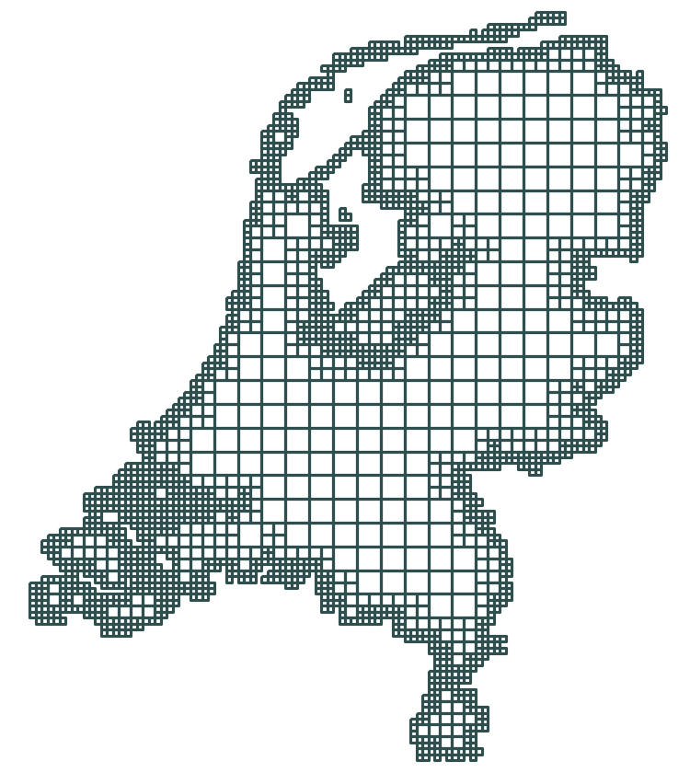
Groundwater Modeling
Mean difference
Summer 2018
Mean difference
Summer 2019
made with nlmod
Notes:
For the ground water level, we looked at the ground water levels during the summer. In the groundwater model, data of KNMI is used for recharge. WITH NL MOD
To see the effect of changing the initial water level for the summer, we took the mean ground water level during the summer months.
As you can see, it depends on the year how big the effect is, but the most effect areas are in the north, which are also nature of grass lands.
Ground water level already varies with climate conditions

Slide 9
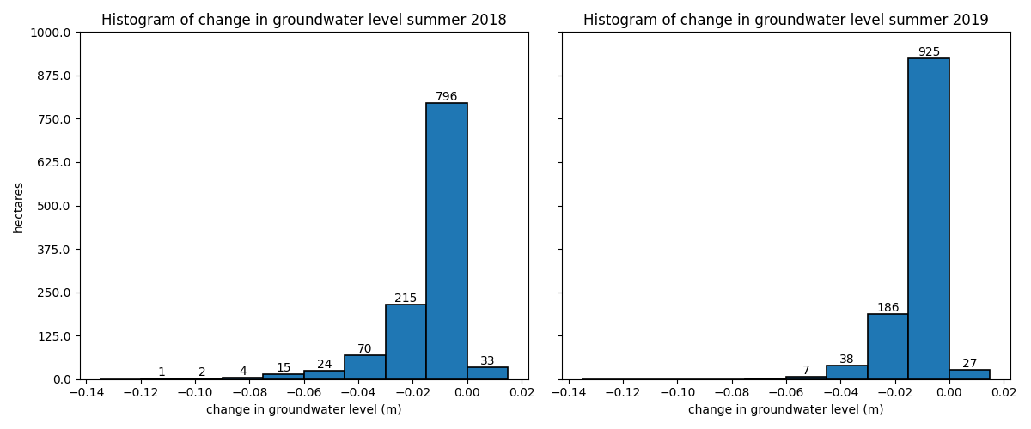
Groundwater Modeling
Change
Summer 2018
Change
Summer 2019
made with nlmod
Notes:
For the ground water level, we looked at the ground water levels during the summer. In the groundwater model, data of KNMI is used for recharge.
To see the effect of changing the initial water level for the summer, we took the mean ground water level during the summer months.
As you can see, it depends on the year how big the effect is, but the most effect areas are in the north, which are also nature of grass lands.
Ground water level already varies with climate conditions

Slide 10
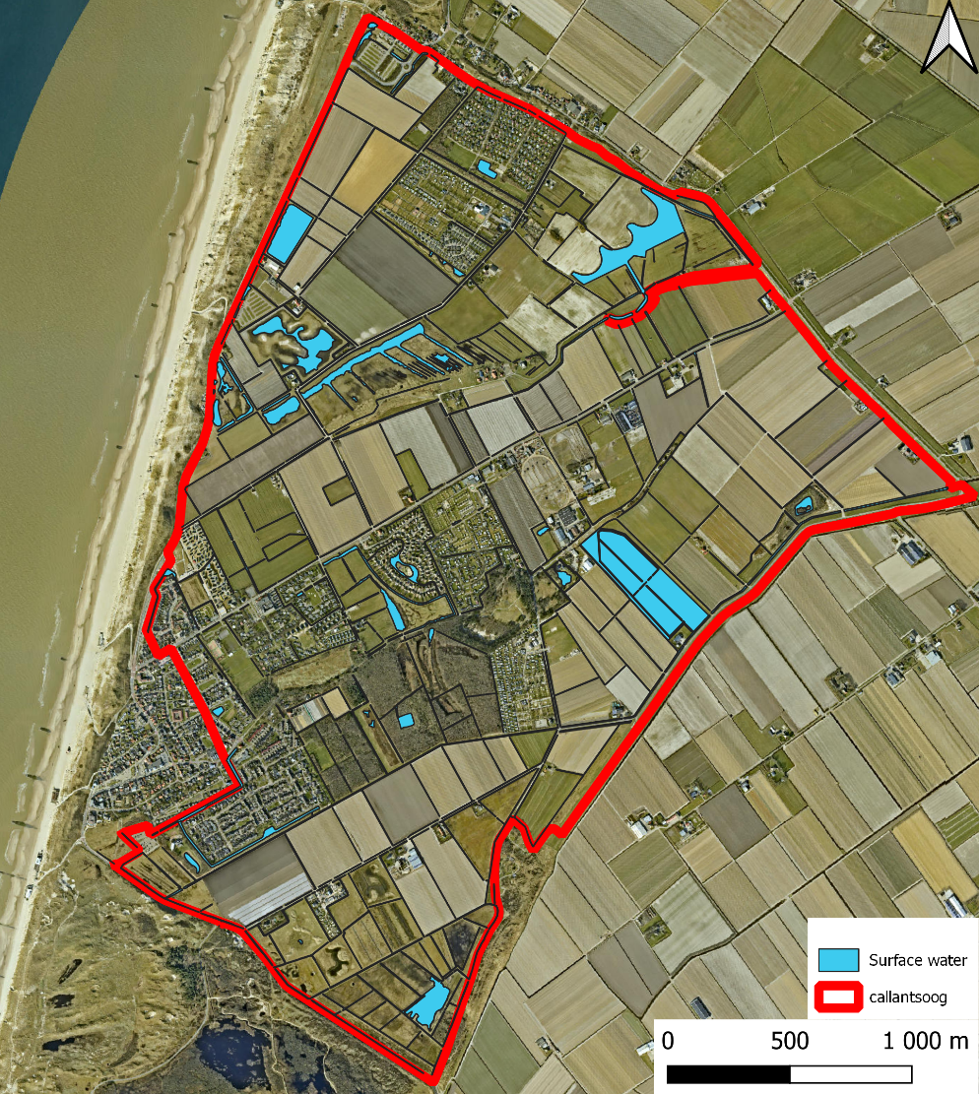
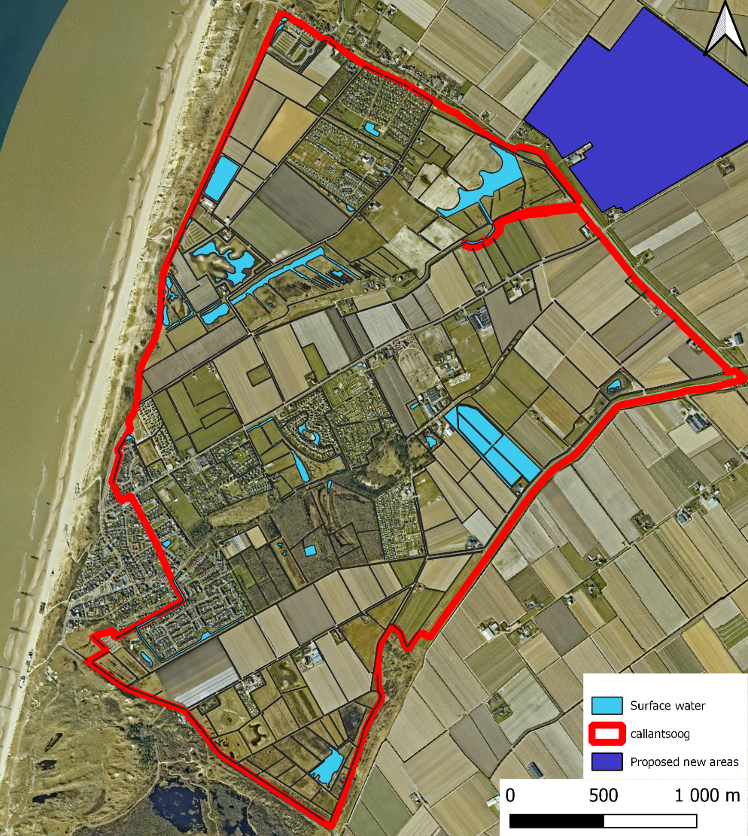
Additional water storage
Current
Proposed
Notes:
Our second strategy is to add an additional water storage. located just north of the polder system.
This location is grass land, which makes it feasible for water storage.
For now the plan is that it is only used for extreme rain events. A gate could be used

Slide 11
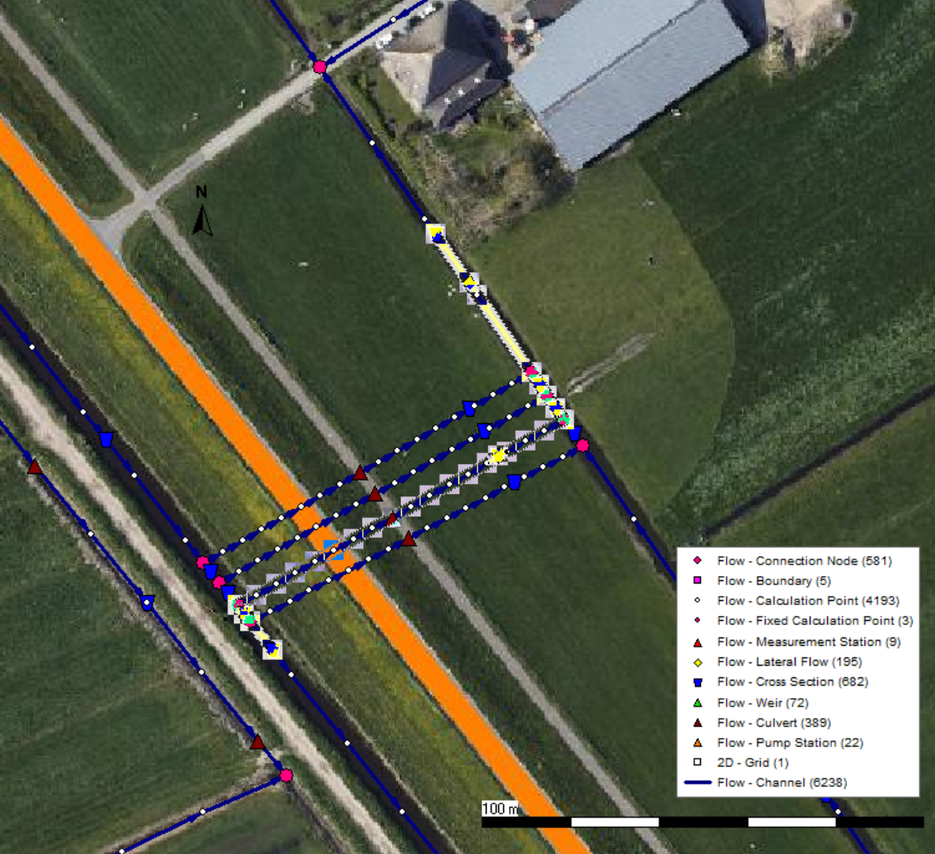
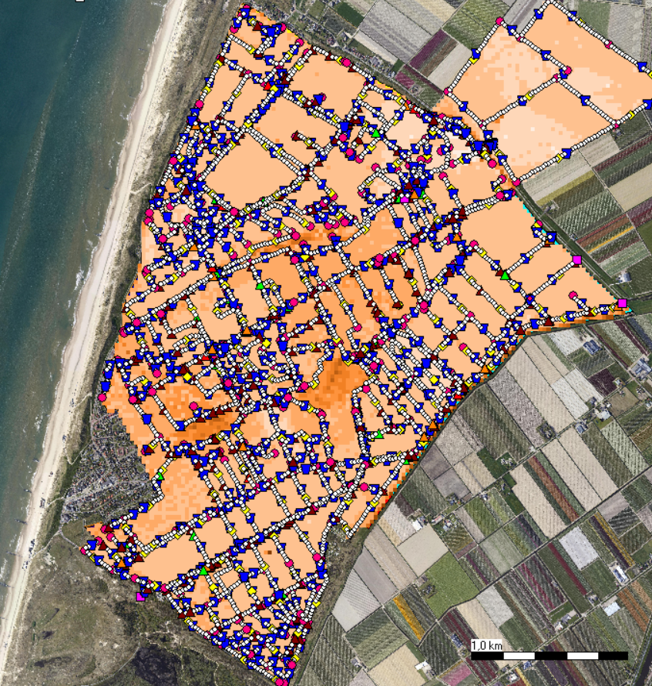
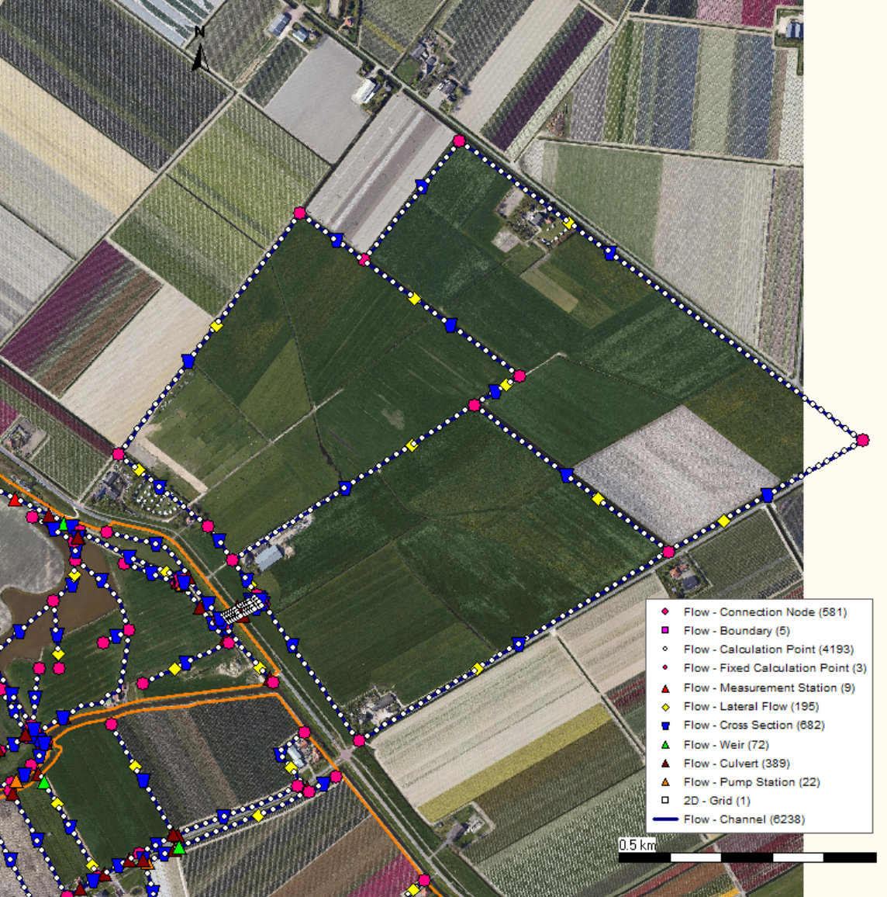
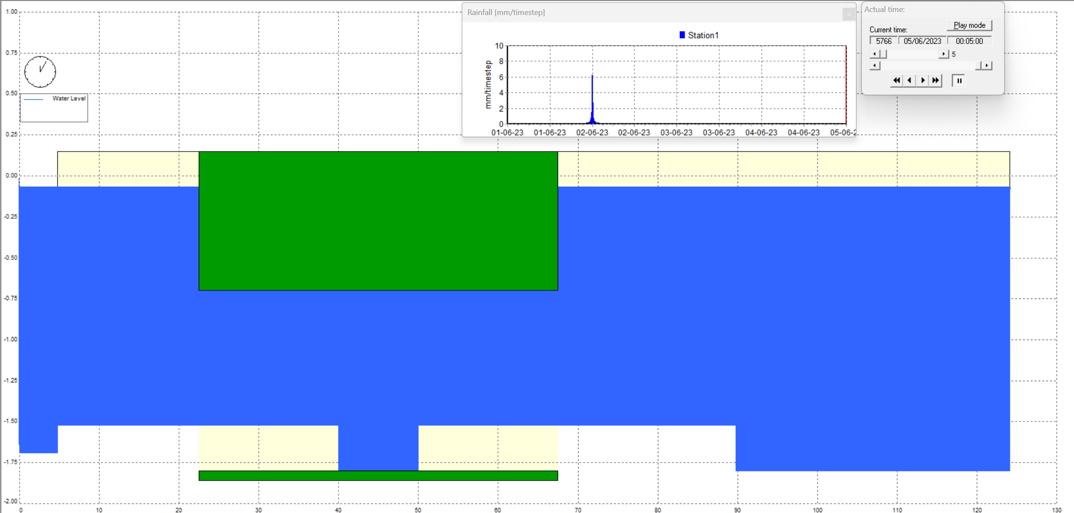
Modeling
4 Round Culverts - ⌀1100 mm
Notes:
The water storage is connected to the system by 4 round culverts. The 4 culverts are added to the sobek model to make a connection between the areas.

Slide 12
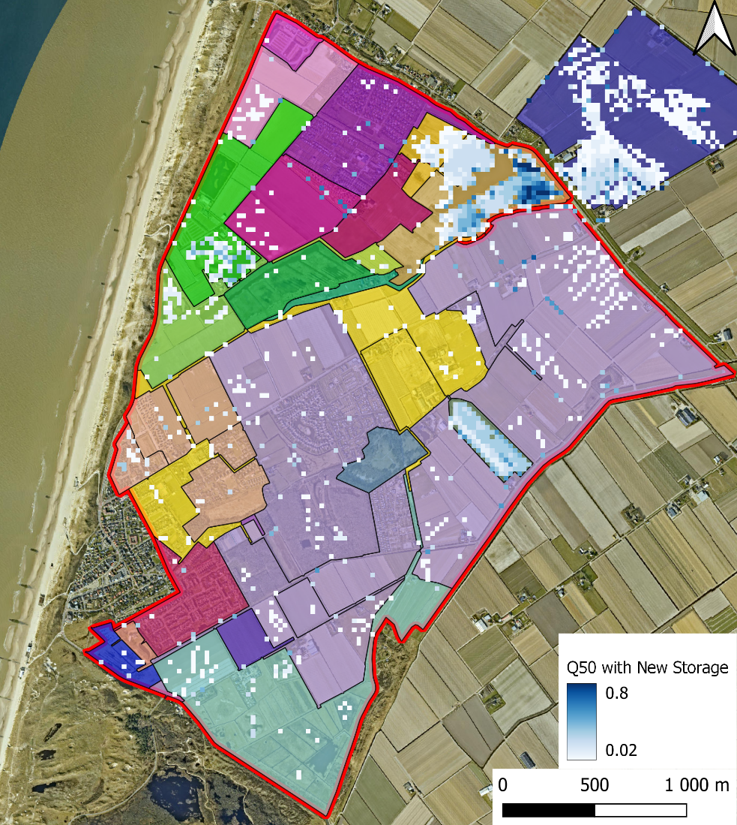
Results
Current
Proposed
T50
37 % flood extent decrease
Notes:
The systems is also modelled in sobek by adding this addition area. We also modelled it with a rain even with return period of 50 years. On the right the result is shown. By adding this extra storage, the flood extent decreases with 37%. In the top part, the flood is also decreased and moved to the water storage location, which is favourable

Slide 13
Overview
Problem: extreme rain events leads to flooding and subsequent damages of stakeholders’ property.
Proposed strategies:
Reduction in the amount of water level decrees
31 decree levels → 10 decree levels
Impact: simplified and controllable
Additional water storage
Addition of flood plain north of the polder
Impact: robust for the coming century
Combining
Notes:
Until now looked at the two strategies seperatly. But we also had a look on the effect of combining the strategies. So adding a water storage in the north of the system and reducing the water level decrees.

Slide 14
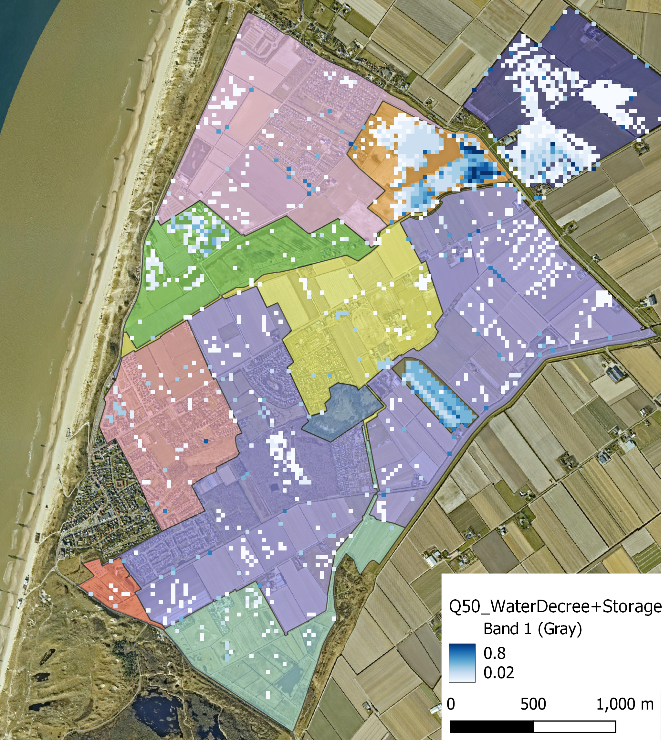
Combined Results
Current
Proposed
T50
26% Flood extent decrease
Notes:
In the middle there is more floods compared to strategy 2, but this flood in on nature areas.

Slide 15
Stakeholders
Nature
Mostly untouched
Farmers
Impact
Decrease in farm area impacted by flooding
Reduction in valuable crop damages
75.83 hectares in NW region lower water levels
Expected response
Continue regulating own water levels
Suggestions (long term)
Adjust farming practices
Land use change (leasing, selling, relocation)
Notes:
Damages = (400,000/hectare) (2.5 hectares/farmer) (20 farmers) = 20,000,000 euros / flood of same scale
The main stakeholders in this project are the farmers. decreasing the flood extent has a possitive effect for the farmers. It results in less crop damages. But on the other hand, almost 76 hectares in the north west region is affected by a lower water level. This has an impact on the way they are farming now.
Because of this, we expect that they will continue regulating their own water levels.
Farming practive --> less effected by water level change.

Slide 16
Next Steps
Testing & optimization
Find ideal weir and pump placement
Cooperation with farmers
Share proposed strategy
Prepare for reactions to system changes
Notes:
(continuation of individual pumping etc.)

Slide 17
Thank you for your attention!

Slide 18
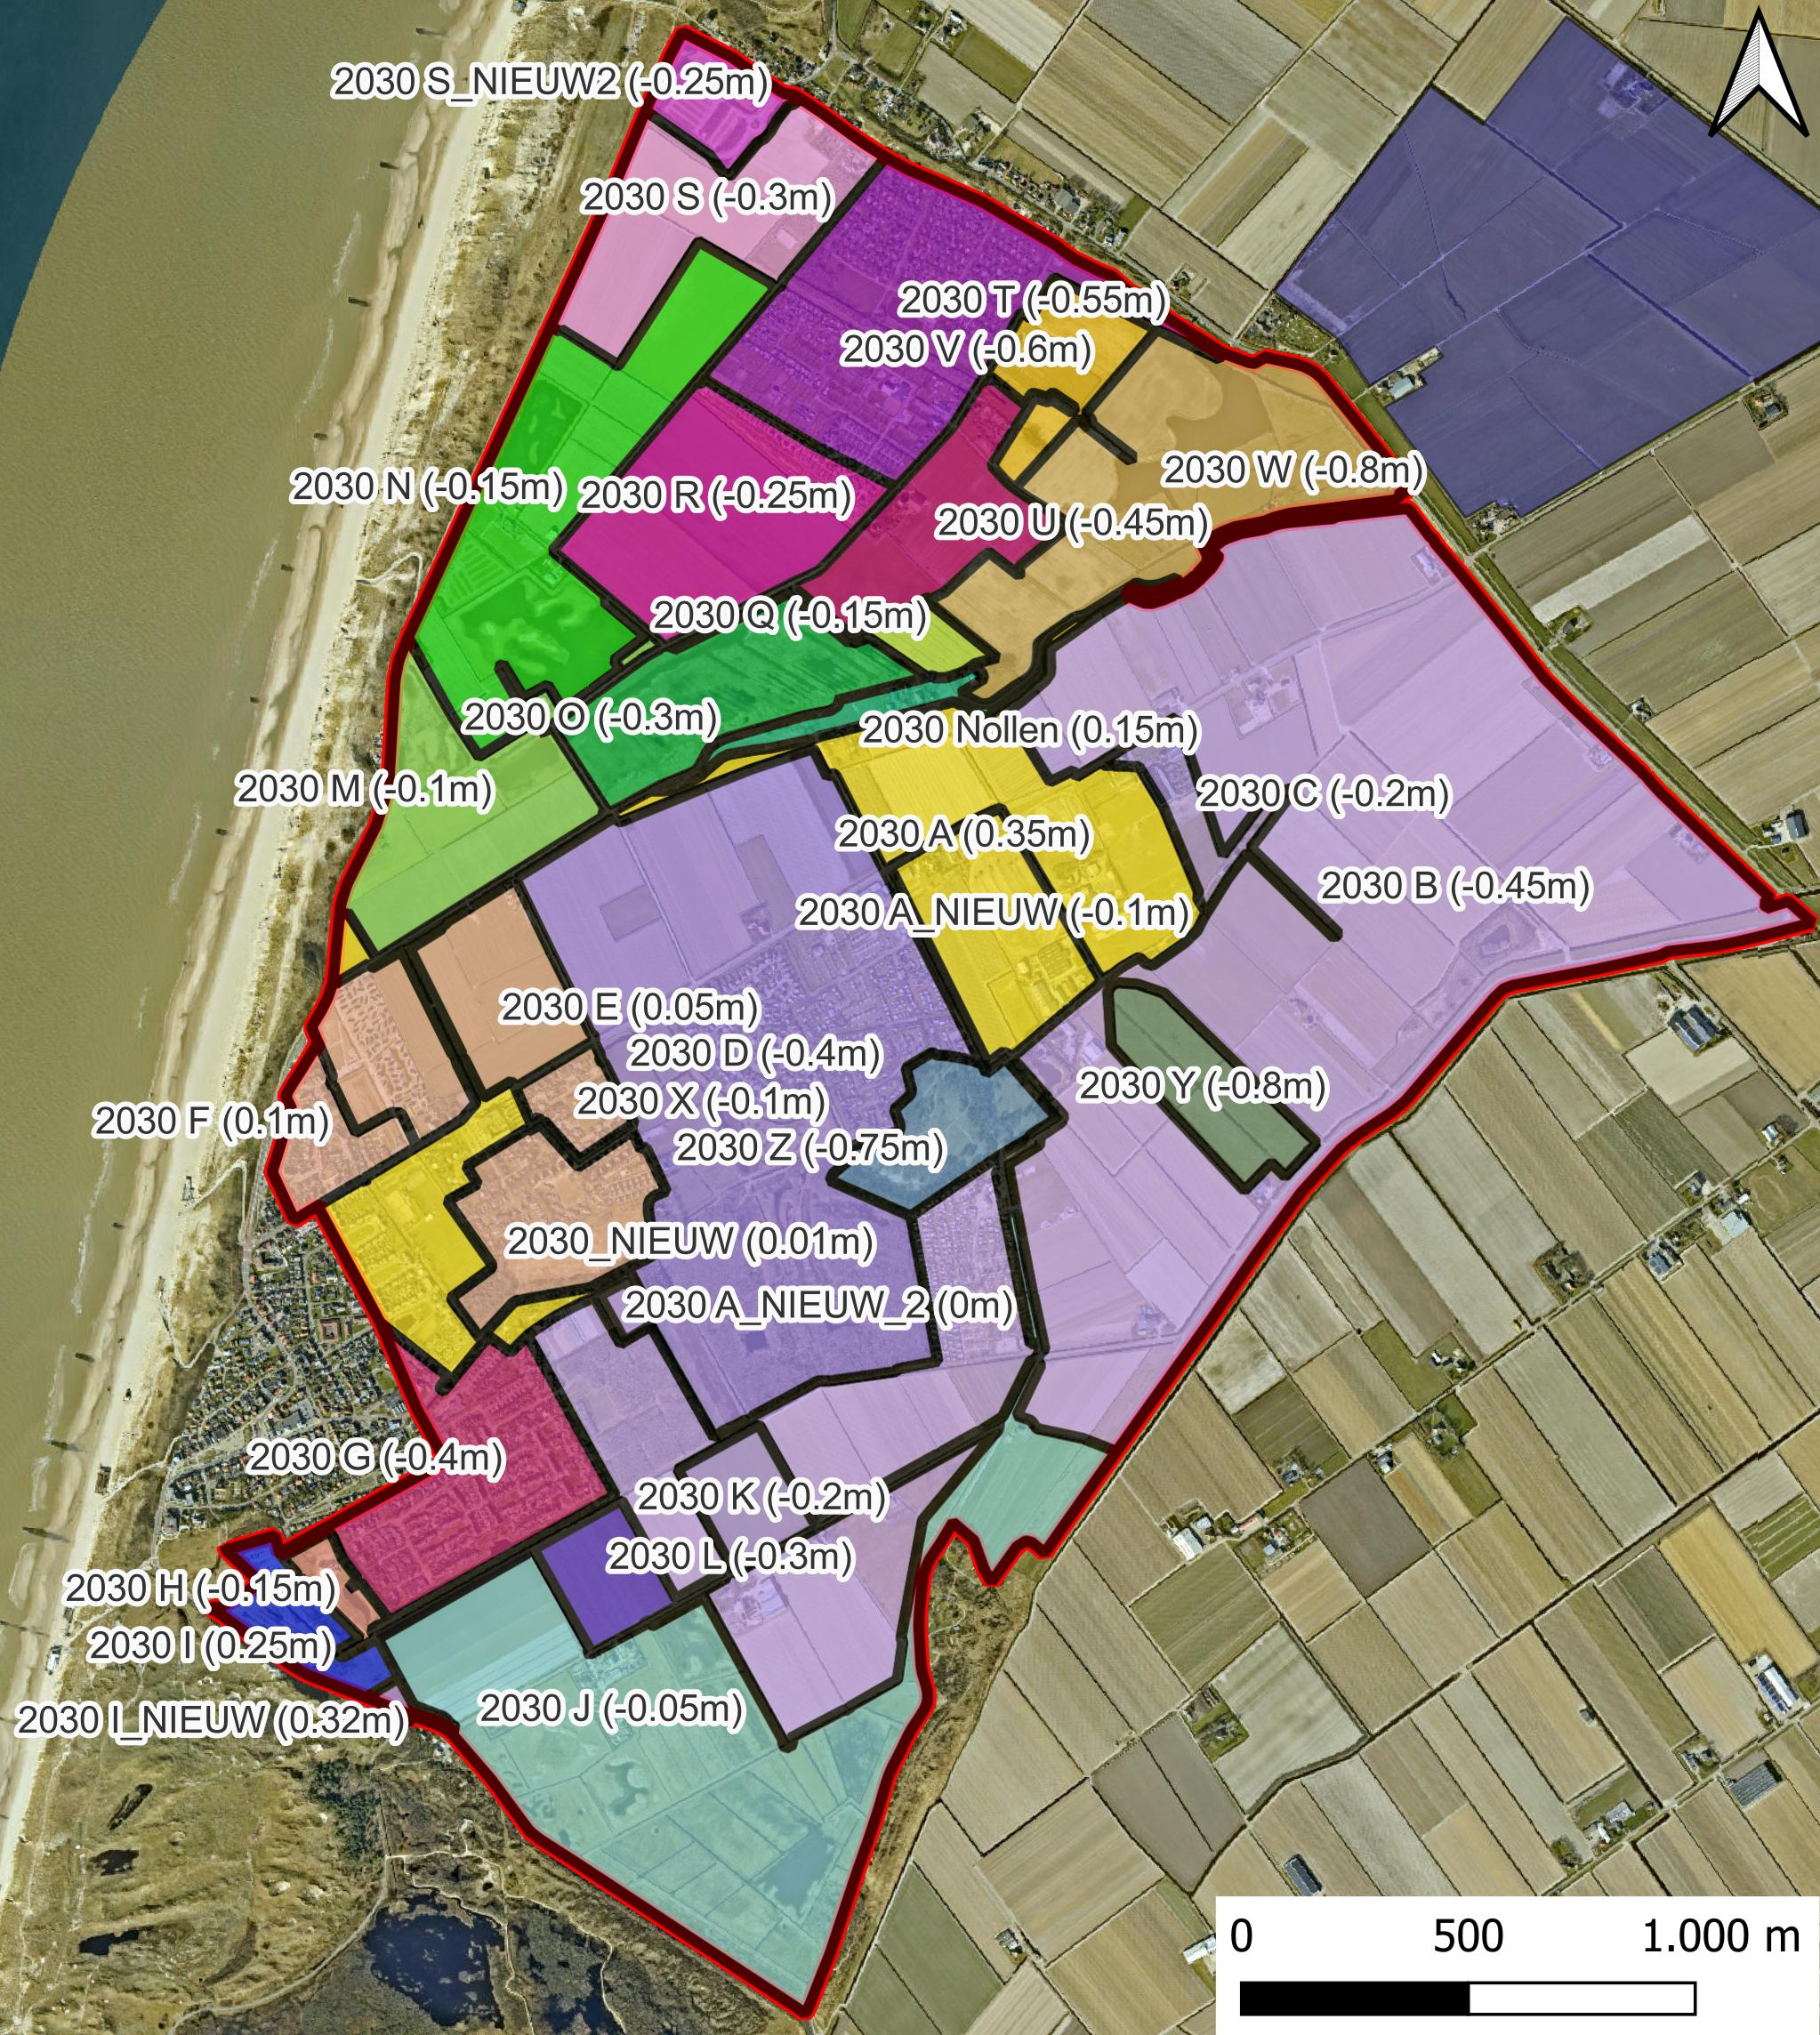
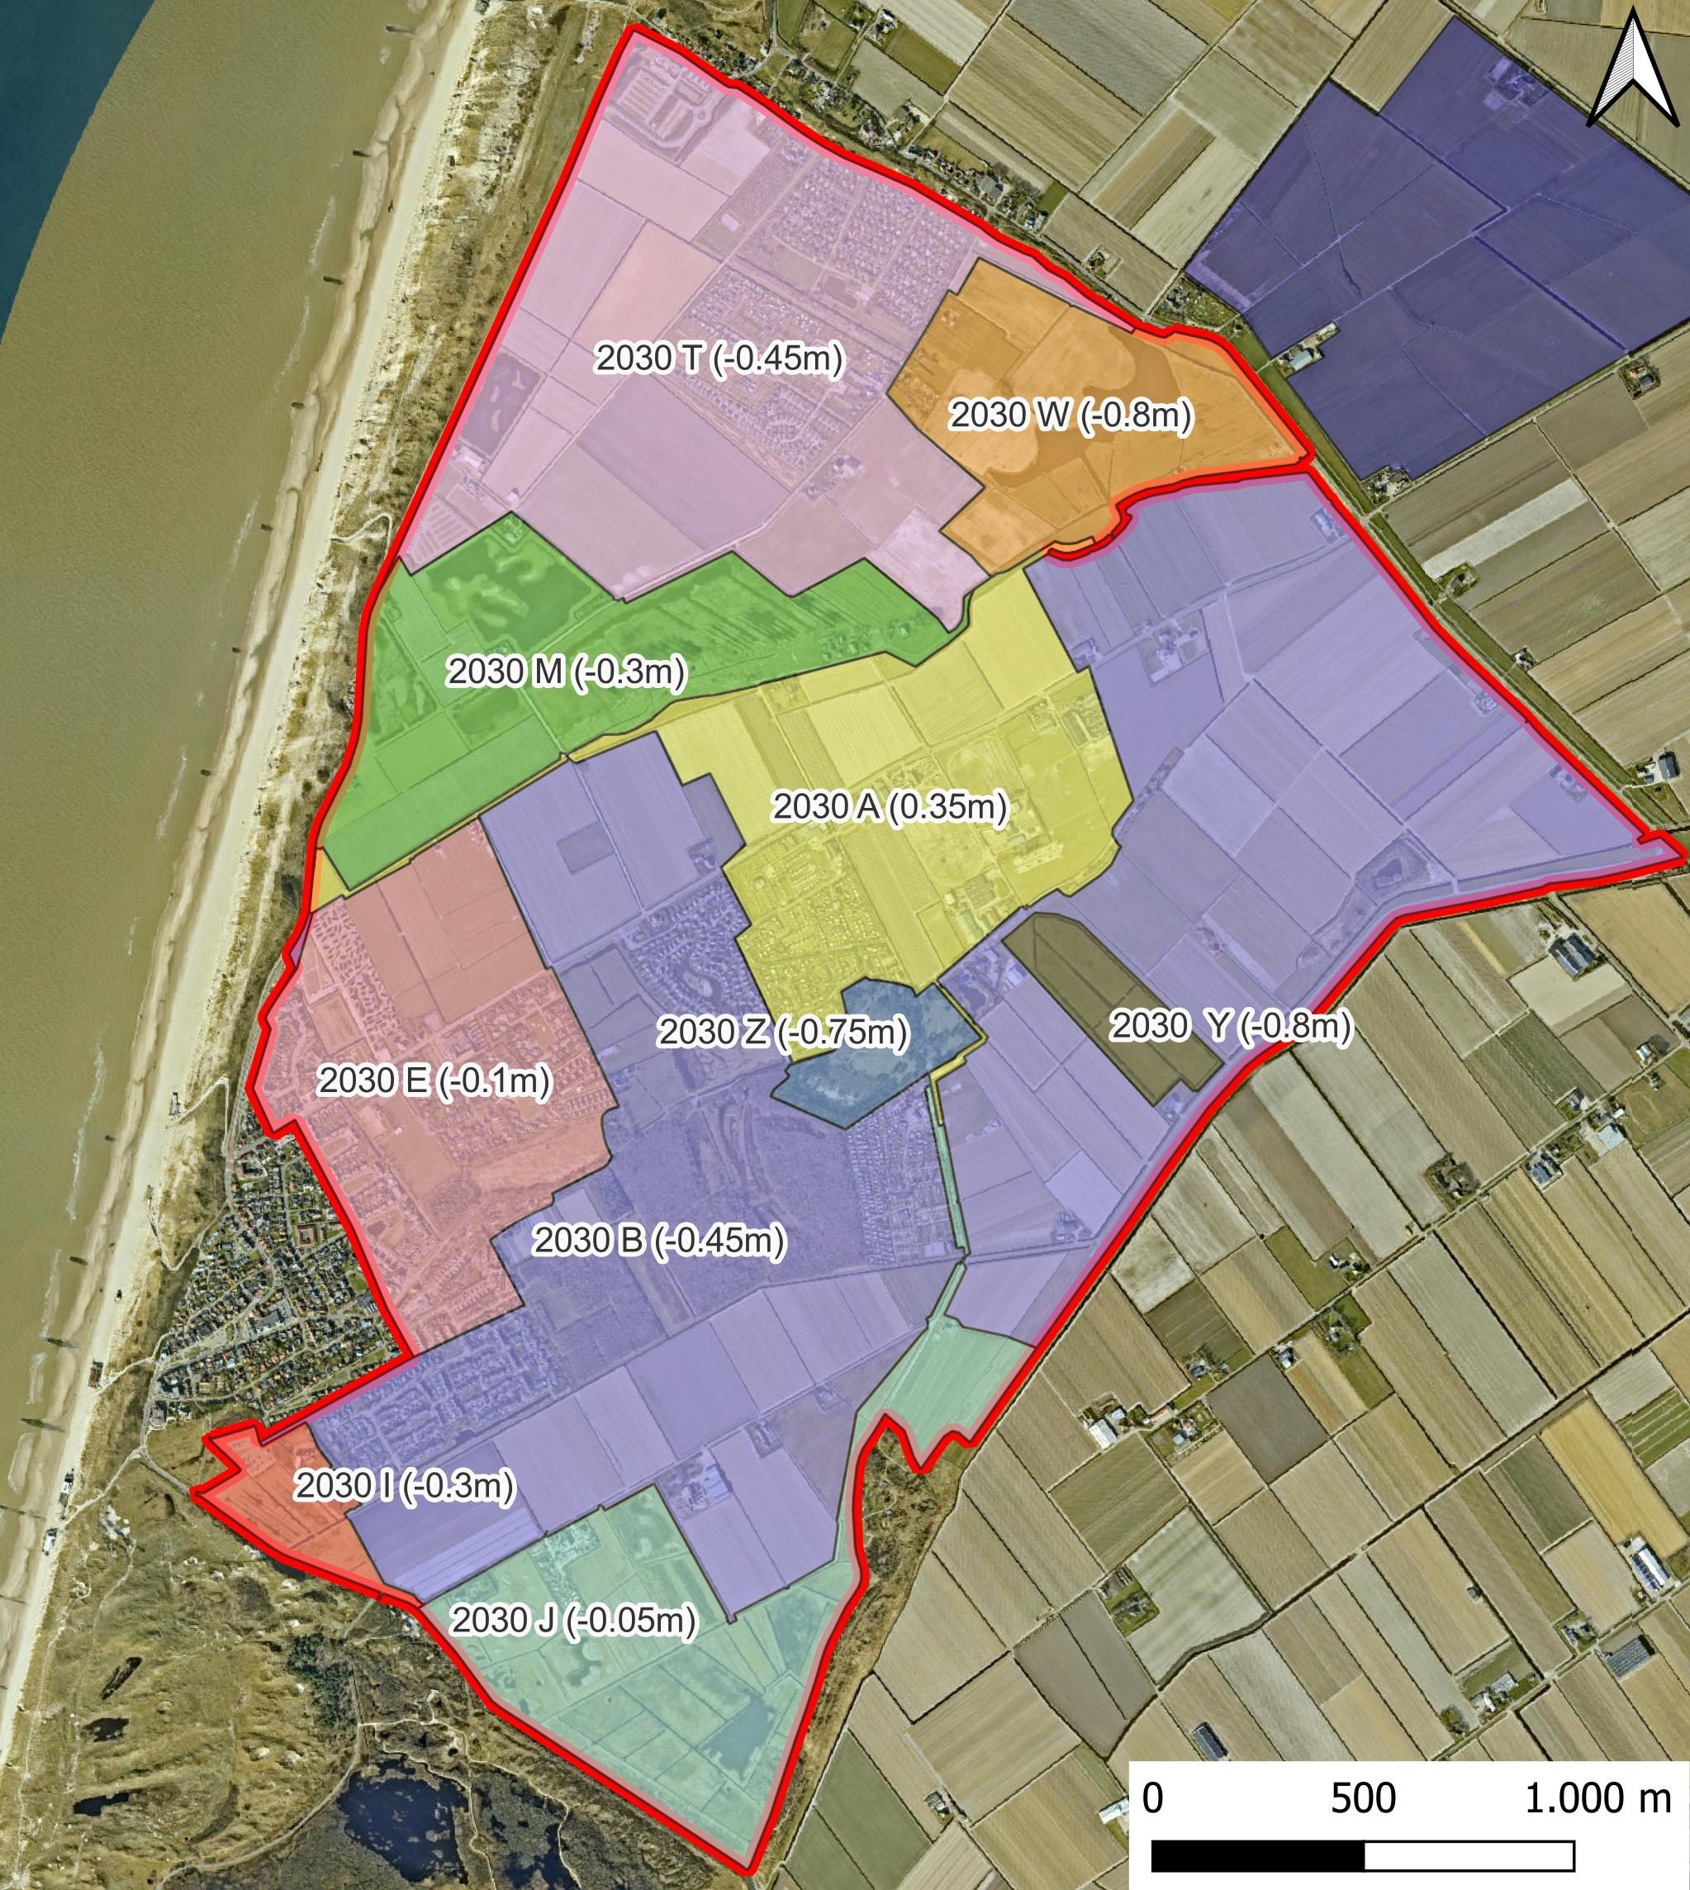
Change of water level decrees – summer levels
Current
Proposed
Notes:
Here is the new system we aimed to reduce this amount, however the nature areas are quite sensitive and different in operation.
For this reason they are left as their own regions. We formed these areas by looking at elevation, current & past land use and infrastructure.

Slide 19
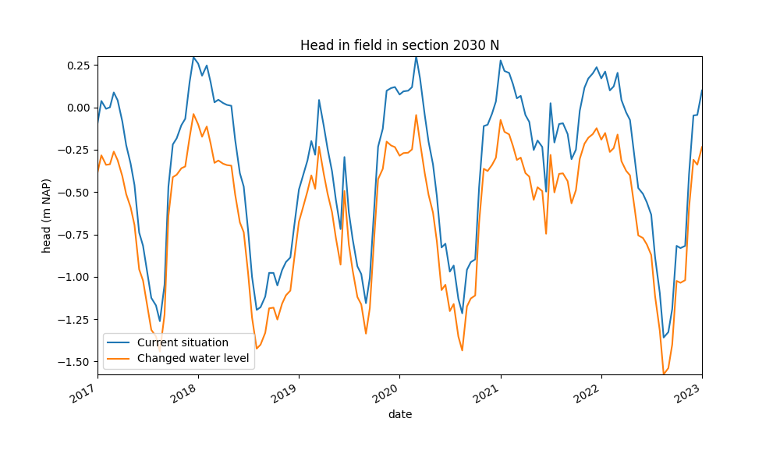
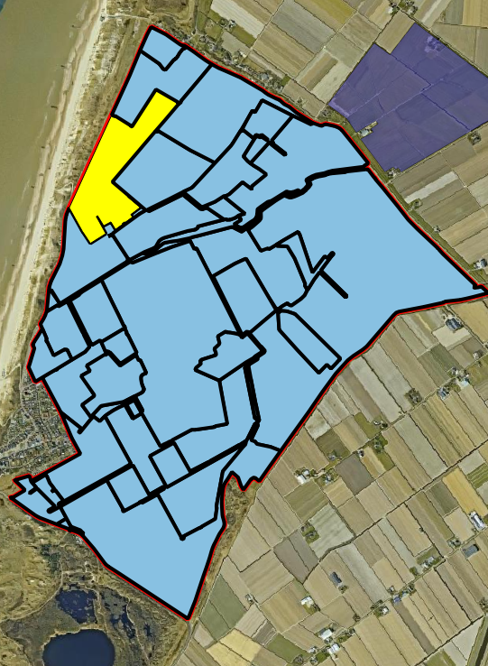
Groundwater level section 2030N
Groundwater level at farm field
Change: –0.15m to –0.45m

Slide 20
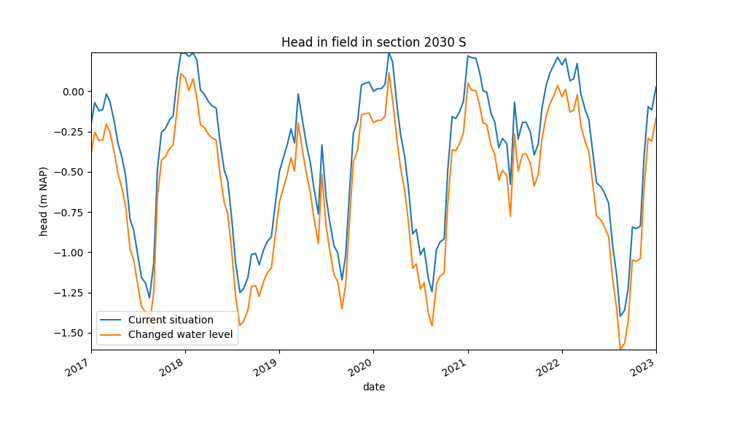
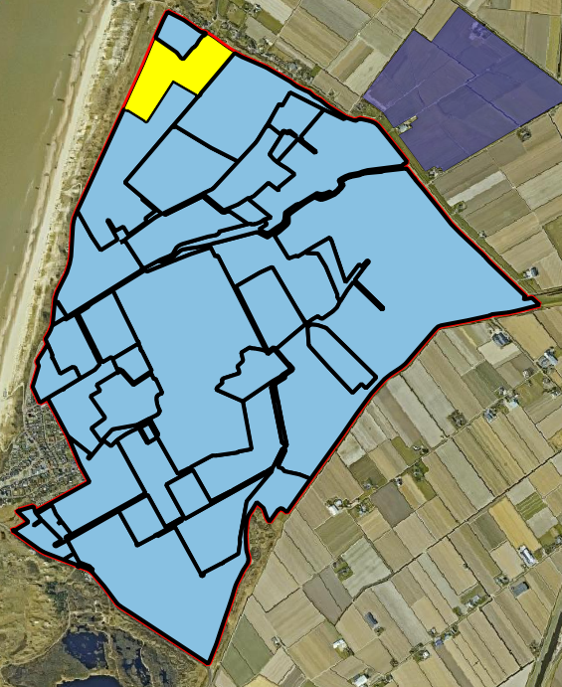
Groundwater level section 2030S
Groundwater level at farm field
Change: –0.30m to –0.45m

Slide 21
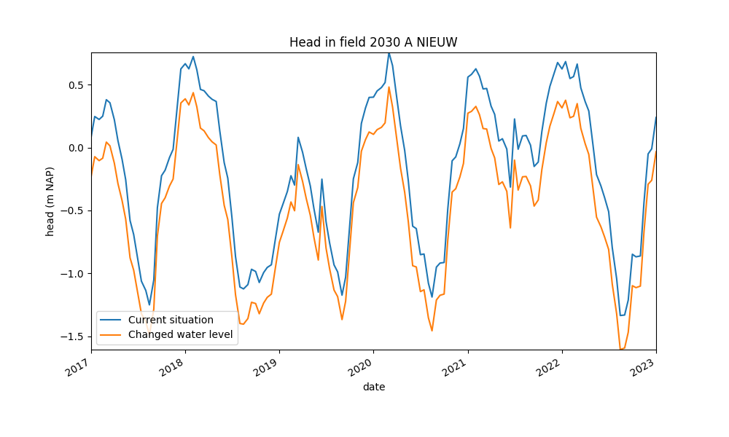
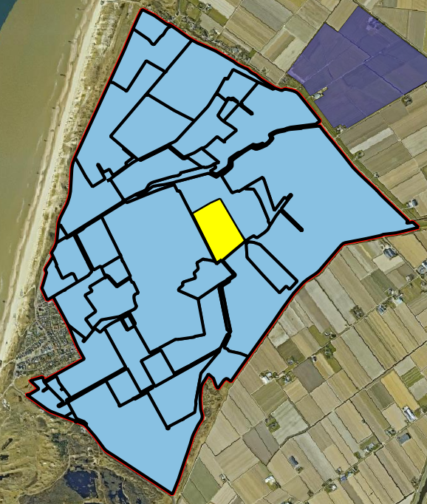
Groundwater level section 2030A NIEUW
Groundwater level at farm field
Change: –0.10m to 0.35m
Notes:
Effected by surrounded areas

